Slide 1
Medical Perspective on Abortion
When does life begin?
Dr. Bill Morehouse September 15, 2006

Slide 2
In the beginning
God created the heavens and the earth.
And the earth was formless and void, and there was darkness over the surface of the deep; and the Spirit of God was moving over the surface of the waters.
Then God said, “Let there be light”; and there was light. Genesis 1:1-3

Slide 3
Creation of the Universe
Big Bang – “Let there be light”
  Expansion and consolidation of dimensions
  Second Law of Thermodynamics
  Laws of physics “compossible with life”
  A Scientist argues with God
Creation of Life by Accident
  Order vs. Complexity
  Staggering information generation problem

Slide 4
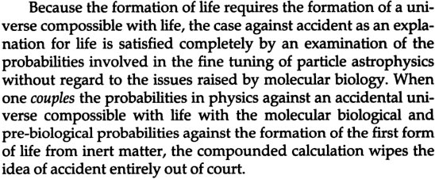
Compossible with life
Dean L. Overman, attorney and scholar

Slide 5
God and the Astronomers
The Astrophysicist’s Nightmare
“For the scientist who has lived by his faith in the power of reason, the story ends like a bad dream. He has scaled the mountains of ignorance; he is about to conquer the highest peak; as he pulls himself over the final rock, he is greeted by a band of theologians who have been sitting there for centuries.”
Robert Jastrow, agnostic astronomer

Slide 6
An addition to your bookshelf
A Case Against Accident
and Self-Organization
by Dean L. Overman
Rowman & Littlefield, 2001

Slide 7
Then God said,
“Let us make man in our image, according to our likeness; and let them rule over the fish of the sea and over the birds of the sky and over the cattle and over all the earth, and over every creeping thing that creeps on the earth.”
And God created man in his own image, in the image of God he created him; male and female he created them. Genesis 1:26-27

Slide 8
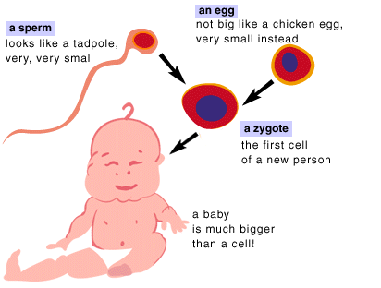
The old math: 1 + 1 = 1

Slide 9
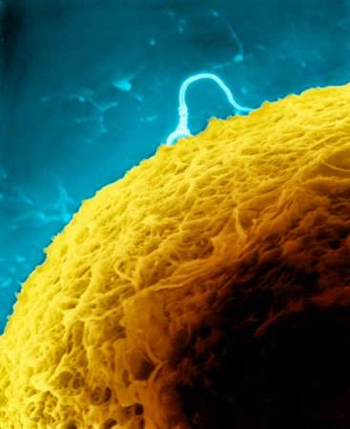
Egg & Sperm coming together

Slide 10
The Incredible Cell
“Perhaps in no other area of modern biology is the challenge posed by the extreme complexity and ingenuity of biological adaptations more apparent than in the fascinating new molecular world of the cell. To grasp the reality of life as it has been revealed by molecular biology, we must magnify a cell a thousand million times until it is twenty kilometers in diameter and resembles a giant airship large enough to cover a great city like London or New York. What we would then see would be an object of unparalleled complexity and adaptive design.

Slide 11
Supreme and bewildering
“On the surface of the cell we would see millions of openings, like the port holes of a vast space ship, opening and closing to allow a continual stream of materials to flow in and out. If we were to enter one of these openings we would find ourselves in a world of supreme technology and bewildering complexity… It is the sheer universality of perfection, the fact that everywhere we look, to whatever depth we look, we find an elegance and ingenuity of an absolutely transcending quality, which so mitigates against the idea of chance…

Slide 12
Complex beyond our capacities
“Is it really credible that random processes could have constructed a reality, the smallest element of which – a functional protein or gene – is complex beyond our own creative capacities, a reality which is the very antithesis of chance, which excels in every sense anything produced by the intelligence of man?”
Michael Denton – Wistar Institute Symposium, 1966

Slide 13
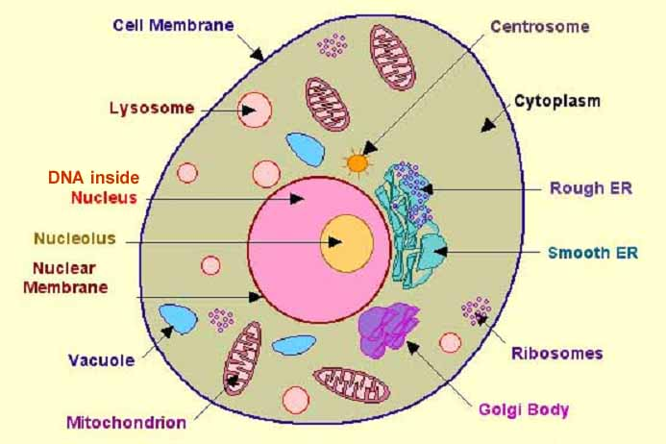
Interior view of a cell

Slide 14
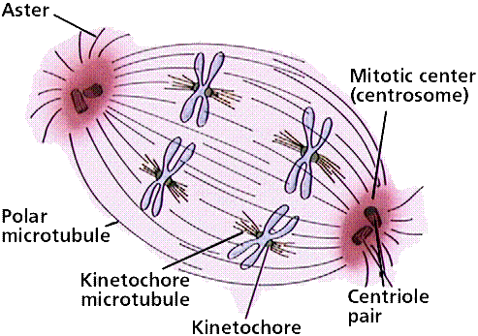
Chromosomal division

Slide 15
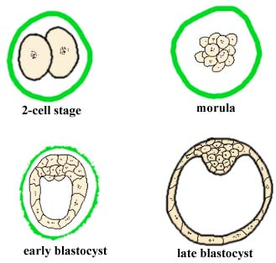
Week 1 - Early stages

Slide 16
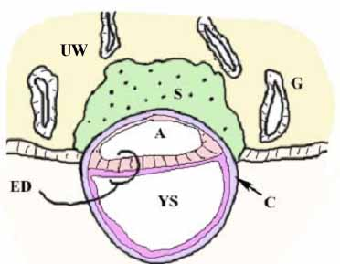
Week 2 - Implantation
A - amniotic cavity
C - cytotrophoblast
ED - embryonic disc
G - glands
S - syncytiotrophoblast
UW – uterine wall
YS - primary yolk sac

Slide 17
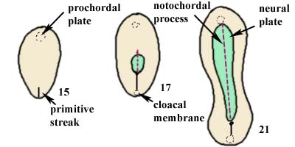
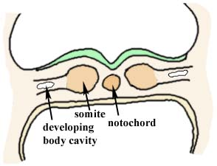
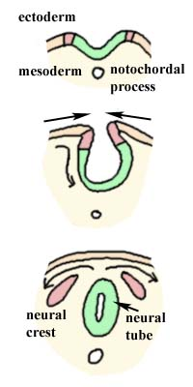
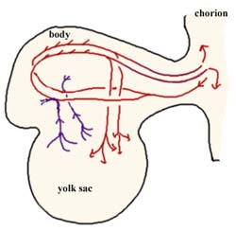
Embryo at 3+ weeks
During these critical weeks an embryo is formed and undergoes a transformation in which all of the body systems begin to take shape: brain, spinal cord, heart, lungs, digestive organs, limbs, etc.

Slide 18
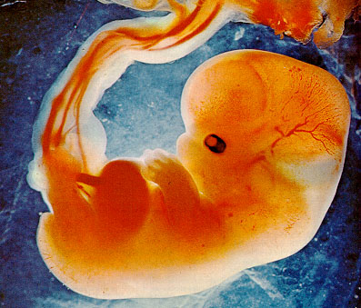
Embryo at 6 weeks

Slide 19
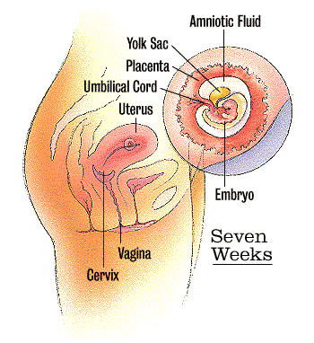
Embryo at 7 weeks
By seven weeks, the egg and sperm have developed into an embryo about the size of a raspberry that has a tiny beating heart. The baby will be growing very fast in the next few weeks.

Slide 20
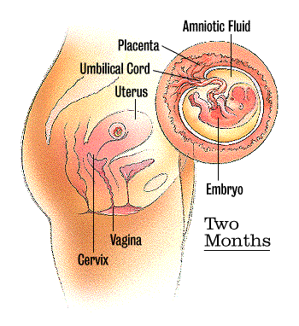
Embryo at 2 months
The baby is now about the size of a kidney bean and is constantly moving and shifting. Her arms and legs may be long enough to meet in front of her body, and she has distinct, slightly webbed fingers.

Slide 21
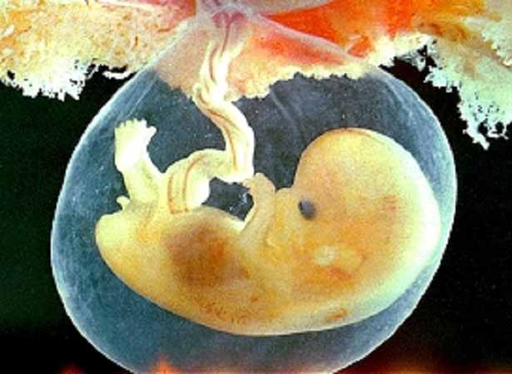
A little person

Slide 22
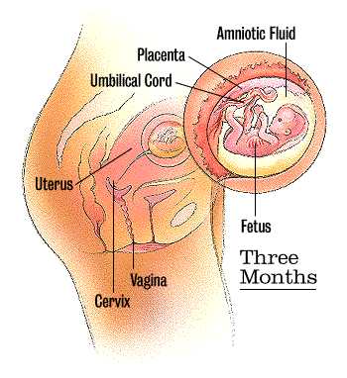
Fetus at 3 months
The baby is now about 2 inches long. His fingers and toes have separated and he has begun swallowing and kicking. The basic structures of all his organs are in place and beginning to function.

Slide 23
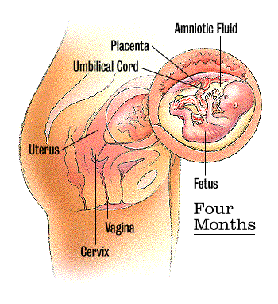
Fetus at 4 months
The baby is now about 4-5 inches long - the size of an avocado. Her heart is pumping about 25 quarts of blood each day and her body is covered with a layer of downy hair called lanugo.

Slide 24
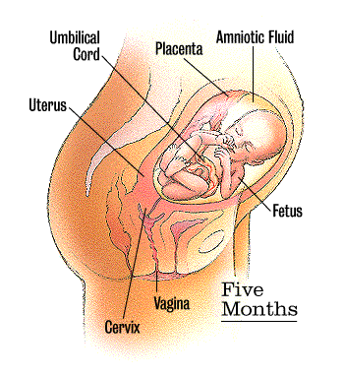
Fetus at 5 months
A creamy, white substance called vernix protects the baby from his long immersion in amniotic fluid. He's swallowing more and giving his digestive system a workout. During an ultrasound, you might see him sucking his thumb.

Slide 25
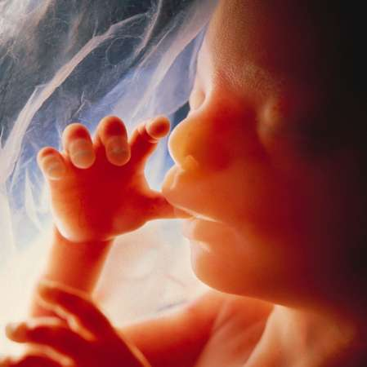
Thumb-sucking

Slide 26
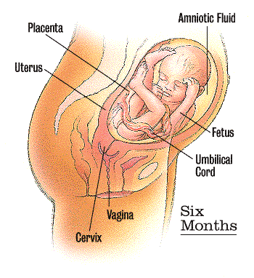
Fetus at 6 months
The baby is viable now, and Mom has started to feel her moving. She’s nearly a foot long and weighs more than a pound. Her red, translucent skin is wrinkled and her lips, eyebrows, and eyelids are distinct.

Slide 27
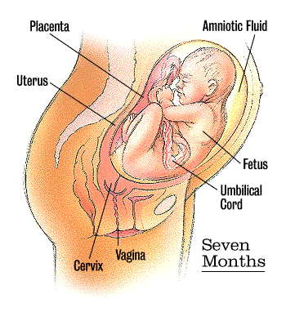
Baby at 7 months
The baby weighs more than 2 pounds and looks more like a newborn. His body is well formed. Fingernails are starting to cover his fingertips. He can now open and close his eyes and may turn toward a source of bright light.

Slide 28
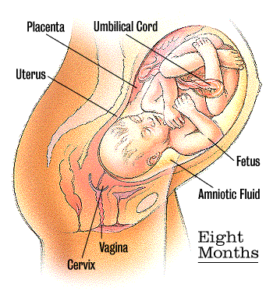
Baby at 8 months
The baby may weigh almost 4 pounds and
have hair or peach fuzz on her head now. She’s gaining about half a pound per week and is probably turned head-down already in preparation for birth.

Slide 29
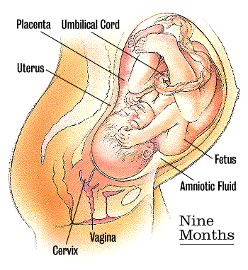
Baby at 9 months
Most of the baby's bones have hardened, although his skull is still pliable. He's shedding most of the downy covering of hair as well as the creamy vernix that covered his body. He'll spend the next few weeks just putting on weight.

Slide 30
How we were made
For you created my inmost being; you knit me together in my mother's womb. I praise you because I am fearfully and wonderfully made; your works are wonderful, I know that full well. My frame was not hidden from you when I was made in the secret place. When I was woven together in the depths of the earth, your eyes saw my unformed body. All the days ordained for me were written in your book before one of them came to be.
Psalm 139.13-16

Slide 31
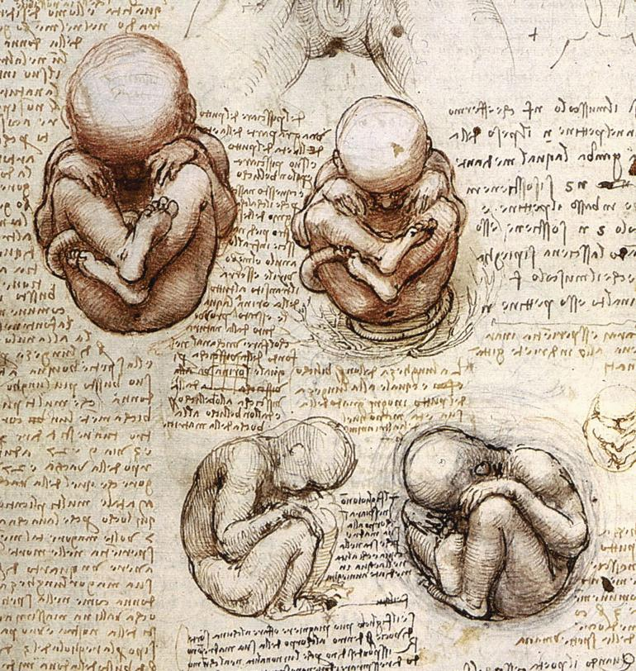
daVinci

Slide 32
Abortion Methods
IUD, “EC” (morning after) and some BCPs?
RU-486 Pill
Menstrual Extraction
Dilation & Curettage (D&C)
Suction Aspiration
Dilation and Evacuation (D&E)
Partial Birth Abortion (D&X)
Saline/Urea Injection
Prostaglandin Abortion
Hysterotomy, Early C-section
Hysterectomy

Slide 33
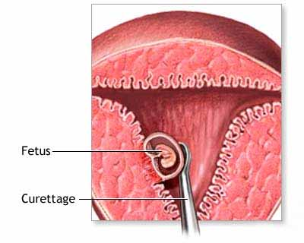
D&C abortion procedure
6-8 weeks

Slide 34
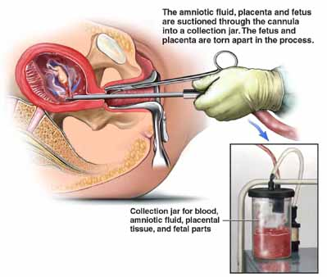
Suction aspiration procedure
8-12 weeks

Slide 35
Death of the fetus
Q. When you perform an abortion by the suction curettage method does it ever happen that a portion of the fetus is extracted from the uterus while the fetus is still alive?
A. Yes.
Q. And how does that happen?
Well, when we do a suction curettage abortion, you know, roughly one of three things is going to happen during the abortion. One would be is that the catheter as it approaches the fetus, you know, tears it and kills it at that instant inside the uterus. The second would be that the fetus is small enough and the catheter is large enough that the fetus passes through the catheter and either dies in transit as it's passing through the catheter or dies in the suction bottle after it's actually all the way out.
Dr. Martin Haskell

Slide 36
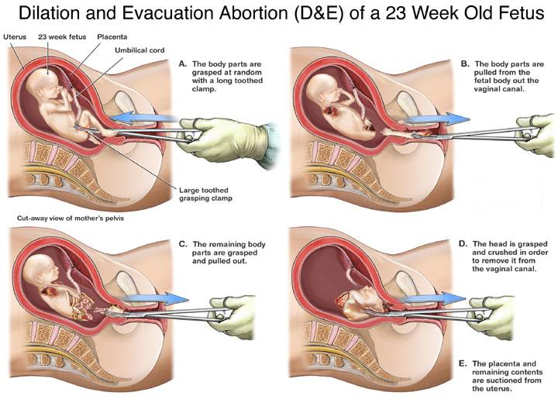
D&E abortion procedure

Slide 37
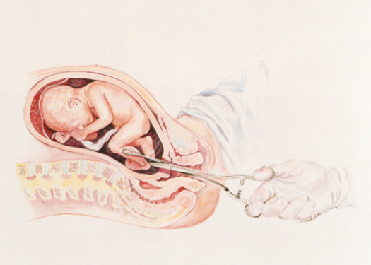
D&X Partial birth abortion – 1
24+ weeks

Slide 38
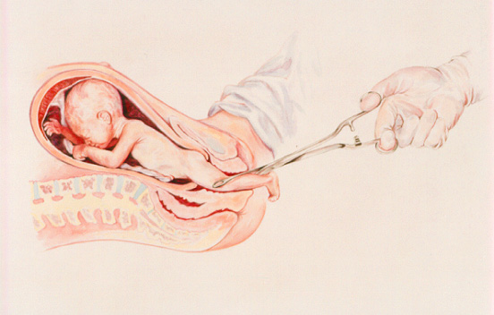
D&X – 2

Slide 39
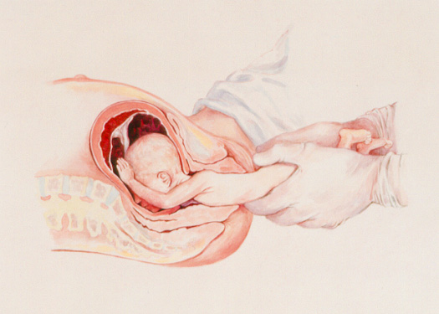
D&X – 3

Slide 40
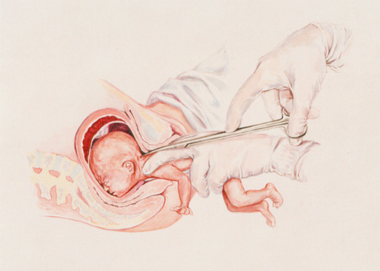
D&X – 4

Slide 41
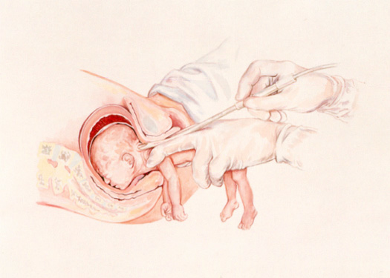
D&X – 5

Slide 42
Is this really happening?
Are we really so blind and uncaring?
Accountability to our Creator
Pray for wisdom and insight.
Pray for conviction and repentance.
Pray for apathy to be overcome.
Pray for support for all whose lives are threatened and for those who are reaching out to them in Jesus’ Name.

Slide 43

God bless you!
2024 Video: https://tinyurl.com/yesolivia – Support: www.caringchoicesphc.com

