Slide 1
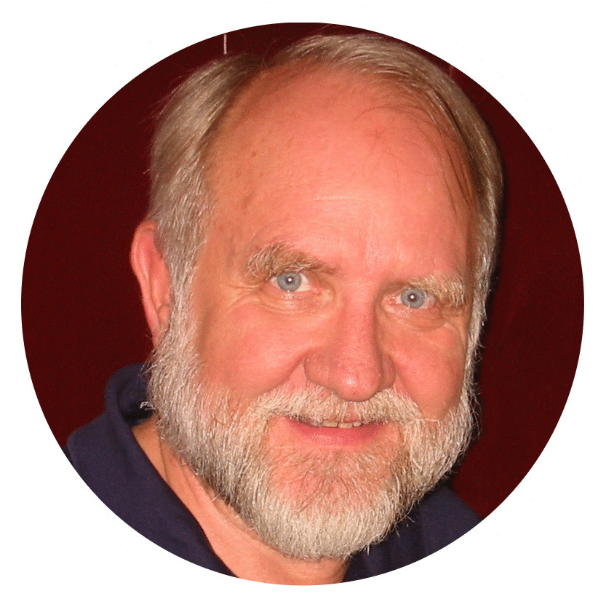
What
matters?
GOOD MORNING!
Men’s Bible Study
April 25, 2024
Bill Morehouse

Slide 2
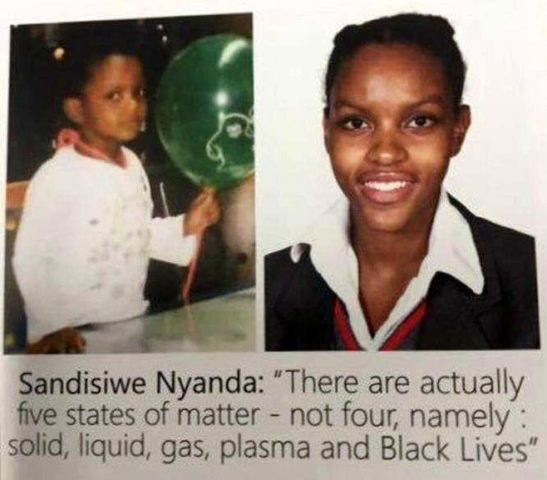

Slide 3
Definitions of “matter(s)”
👆
Noun:
  Physical substances in general that take up space and can be weighed, as distinct from mind and spirit
  Affairs or situations under consideration
  Christian Science: The illusion that the objects perceived by the physical senses have the reality of substance
  Hinduism: God alone exists and everything else is “Maya” or illusion.
Verb:
  Being of importance, consequence, relevance, or significance

Slide 4
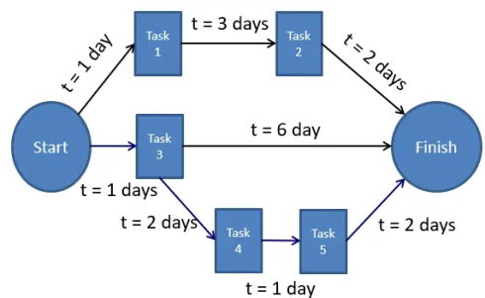
Characteristics of “matter(s)”
👆
Various sizes and weights
Various levels of consequences/importance
Timeliness/orderliness: cronos, kairos, science
Priorities of importance, order, and sequence
Program Evaluation and Review Technique (PERT)

Slide 5
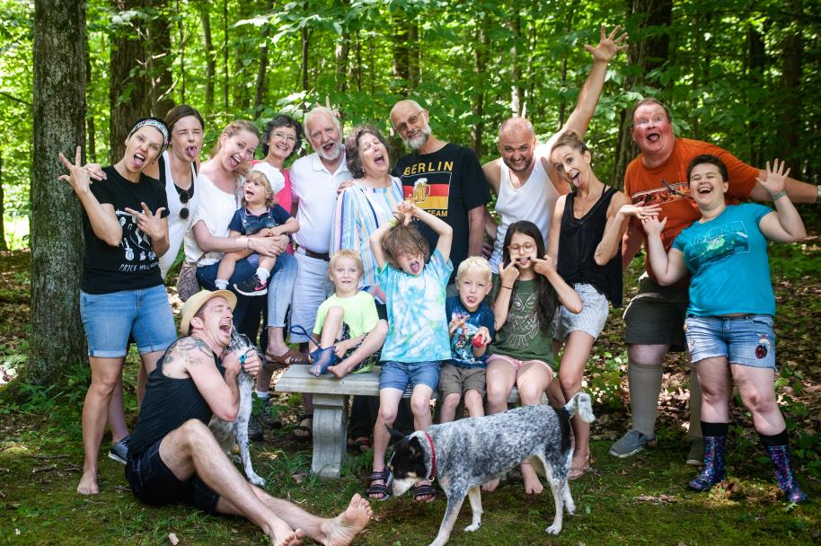
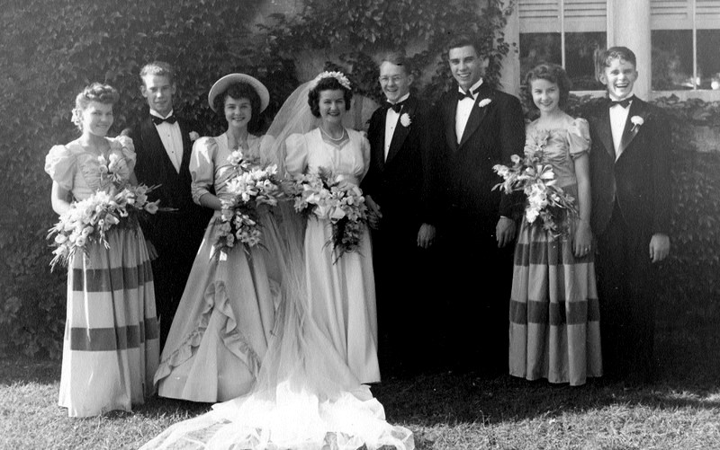

Slide 6
Questions for thought
👆
Which of the following may contain but are not composed of matter?
Words, thoughts, ideas, concepts, ideologies
God and other gods, powers, principalities, angels and demons
Space, time, infinity, eternity
Light/darkness, beauty, love, joy, reason, wisdom, choice, justice, good/evil, rewards/punishments
Are immaterial things immaterial?
Do immaterial matters matter?
Is the notion that the universe was, is, and always will be a pantheistic counterfeit of “I AM ”?
Do “Black Lives Matter”?

Slide 7

PATRISSE CULLORS – BLM co-founder
“In high school, I came out to my friends as queer. My entire world opened up; this was a monumental step toward unveiling my truest self. I had my first girlfriend when I was sixteen years old. ”
“In June of 2015 – the same month Obergefell was decided – I met Janaya Khan. I knew without a doubt that Janaya, a black transgender immigrant, was my life partner. We could build a new narrative steeped in the intersections of black love.”
AABBF 1983, ID queer black cis-gender female, pronouns she/her, activist/artist/writer

Slide 8
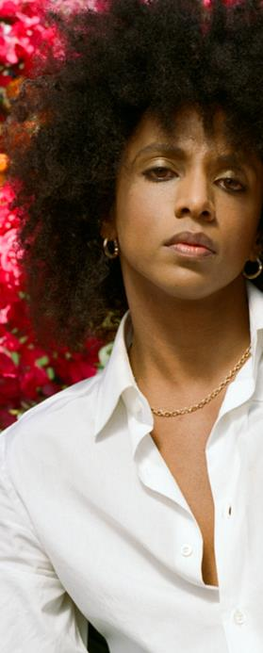
JANAYA KHAN – BLM co-founder
“We think that we live in a society organized around these binaries. But if there isn’t just the gender of male and female, then maybe a lot of other things in society aren’t true either. We have to let go of the scripts we’re born into.”
“We’re building a belief system – a world outside the colonial imagination. Our job Is to make revolution irresistible. We become remarkable when we fight for freedom, justice and liberation.”
AABBM 1987, ID transgender black non-binary, pronouns they/them, activist/boxer/model

Slide 9
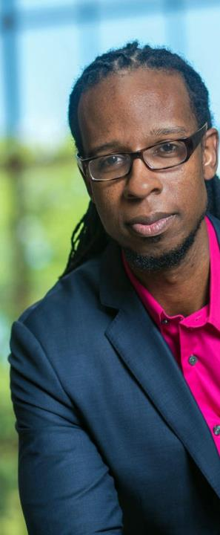
IBRAM X. KENDI – anti-racist guru
“I’m a preacher’s kid. Jesus was a revolutionary. And the job of the Christian is to revolutionize society, to liberate society from the powers on Earth that are oppressing humanity.”
“Savior theology is a different type of theology that goes right in line with racist ideas and racist theology. That type of theology breeds bigotry. Anti-racists fundamentally reject savior theology.”
AABBM 1982, ID straight black cis-gender male, pronouns he/him, activist/author/teacher

Slide 10
1.
Spiritual
Reality Matters
What about root problems and priorities?

Slide 11
What is the main root problem?
Not believing in spiritual reality
Not knowing who God is; having a concept at best
Believing in a false god or gods
Not believing in the God of the Bible
Not believing the gospel revelation of Jesus
Not believing in the Trinity of Father, Son, Holy Spirit
Corollary problems
Falling into sin and staying entangled in it
Not having faith in God and His Word
Having false notions, perceptions, or hopes
Holding unbiblical ideologies or eschatological views

Slide 12
What is spiritual?
“You worship what you do not know; we worship what we know, for salvation is from the Jews. But the hour is coming, and is now here, when the true worshipers will worship the Father in spirit and truth, for the Father is seeking such people to worship him. God is spirit, and those who worship him must worship in spirit and truth.”
John 4:22-24
Now we have received not the spirit of the world, but the Spirit who is from God, that we might understand the things freely given us by God. And we impart this in words not taught by human wisdom but taught by the Spirit, interpreting spiritual truths to those who are spiritual.
The natural person does not accept the things of the Spirit of God, for they are folly to him, and he is not able to understand them because they are spiritually discerned. The spiritual person judges all things, but is himself to be judged by no one. “For who has understood the mind of the Lord so as to instruct him?” But we have the mind of Christ.
1 Corinthians 2:1,6-16

Slide 13
What about sin and righteousness?
“When the Holy Spirit comes, he will convict the world concerning sin and righteousness and judgment: concerning sin, because they do not believe in me; concerning righteousness, because I [Jesus] go to the Father, and you will see me no longer; concerning judgment, because the ruler of this world is judged.”
John 1:8-11
Righteousness has these aspects:
    Identity: Being the right person
    Location: in the right place
    Timing: at the right (kairos) time
    Action: doing the right thing(s)
    How: in the right way
    Motivation: for the right reason(s).
Sin is simply absent or corrupted righteousness that falls short in various ways of what would be ideal from God’s perspective, either:
unintentionally through ignorance or carelessness, or
intentionally with awareness of wrongdoing, or
intentionally with premeditation (usually called transgression).

Slide 14
What about priorities?
We, as mortal parts of God’s creation, are very limited in space and time, so we need priorities. We can’t do everything – certainly not all at once – no matter how we try. Our God isn’t bound by any priorities, however. He can pay full attention to and tend to all things at once. Absolutely everything matters to Him, and He has appointed His only begotten Son, Jesus, to manage His affairs in the universe. This Jesus is, as Paul declares in Colossians,
“the image of the invisible God, the firstborn of all creation. For by him all things were created, in heaven and on earth, visible and invisible, whether thrones or dominions or rulers or authorities – all things were created through him and for him. And he is before all things, and in him all things hold together. And he is the head of the body, the church. He is the beginning, the firstborn from the dead, that in everything he might be preeminent. For in him all the fullness of God was pleased to dwell, and through him to reconcile to himself all things, whether on earth or in heaven, making peace by the blood of his cross.”
Colossians 1:15-20

Slide 15
Priority A: God/Light/Word/Life
In the beginning, God created the heavens and the earth. The earth was without form and void, and darkness was over the face of the deep. And the Spirit of God was hovering over the face of the waters (or chaos). And God said, “Let there be light,” and there was light. And God saw that the light was good. And God separated the light from the darkness.
Genesis 1:1-4
In the beginning was the Word, and the Word was with God, and the Word was God. He was in the beginning with God. All things were made through him, and without him was not any thing made that was made. In him was life, and the life was the light of men. The light shines in the darkness, and the darkness has not overcome it.
John 1:1-5
E = mc²
What about Black Holes?

Slide 16
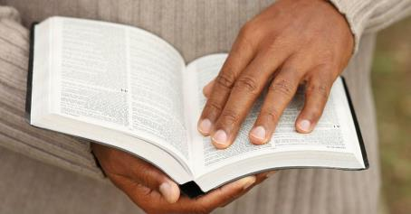
Primacy of the Word of God
The Word of God is of supreme importance in the life of the Christian, containing as it does God’s revelation of his Person, his will and his ways. The Word needs to be pored over, ingested into one’s mind and heart, meditated on, and acted upon. It is a unique and precious repository of spiritual truth and guidance and encouragement. There is no aspect of the life of the church or of the individual believer that should not be tied to a scriptural mooring and infused with biblical substance.
The Gospel Coalition
For the Word of God is living and active, sharper than any two-edged sword, piercing to the division of soul and of spirit, of joints and of marrow, and discerning the thoughts and intentions of the heart.
Hebrews 4:12

Slide 17
Priorities B: Faith, hope, and love
If I speak in the tongues of men and of angels, but have not love, I am a noisy gong or a clanging cymbal. And if I have prophetic powers, and understand all mysteries and all knowledge, and if I have all faith, so as to remove mountains, but have not love, I am nothing. If I give away all I have, and if I deliver up my body to be burned, but have not love, I gain nothing.
Love is patient and kind; love does not envy or boast; it is not arrogant or rude. It does not insist on its own way; it is not irritable or resentful; it does not rejoice at wrongdoing, but rejoices with the truth. Love bears all things, believes all things, hopes all things, endures all things.
Love never ends. As for prophecies, they will pass away; as for tongues, they will cease; as for knowledge, it will pass away. For we know in part and we prophesy in part, but when the perfect comes, the partial will pass away. When I was a child, I spoke like a child, I thought like a child, I reasoned like a child. When I became a man, I gave up childish ways. For now we see in a mirror dimly, but then face to face. Now I know in part; then I shall know fully, even as I have been fully known. So now faith, hope, and love abide, these three; but the greatest of these is love.
1 Corinthians 13:1-4

Slide 18
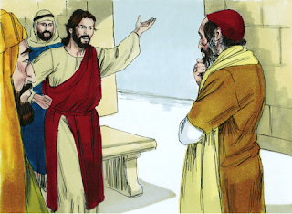
The Great Commandments of Love
And behold, an expert in the Law of Moses stood up to put Jesus to the test, saying, “Teacher, what shall I do to inherit eternal life?” Jesus replied to him, “What is written in the Law? How do you read it?” And he answered, “You shall love the Lord your God with all your heart and with all your soul and with all your strength and with all your mind, and your neighbor as yourself.” And Jesus said to him, “You have answered correctly; do this, and you will live.”
But he, desiring to justify himself, said to Jesus, “And who is my neighbor?”
Luke 10:25-29

Slide 19
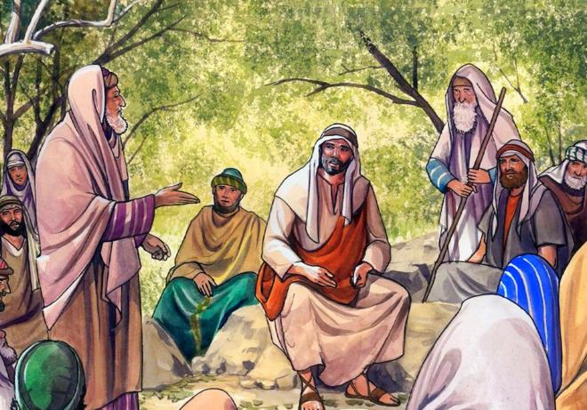
Who is my neighbor?
Jesus replied, “A man was going down from Jerusalem to Jericho, and he fell among robbers, who stripped him and beat him and departed, leaving him half dead. Now by chance a priest was going down that road, and when he saw him he passed by on the other side. So likewise a Levite, when he came to the place and saw him, passed by on the other side. But a Samaritan, as he journeyed, came to where he was, and when he saw him, he had compassion. He went to him and bound up his wounds, pouring on oil and wine. Then he set him on his own animal and brought him to an inn and took care of him. And the next day he took out two denarii and gave them to the innkeeper, saying, ‘Take care of him, and whatever more you spend, I will repay you when I come back.’ Which of these three, do you think, proved to be a neighbor to the man who fell among the robbers?”
He said, “The one who showed him mercy.”
And Jesus said to him, “You go, and do likewise.”
Luke 10:30-37

Slide 20
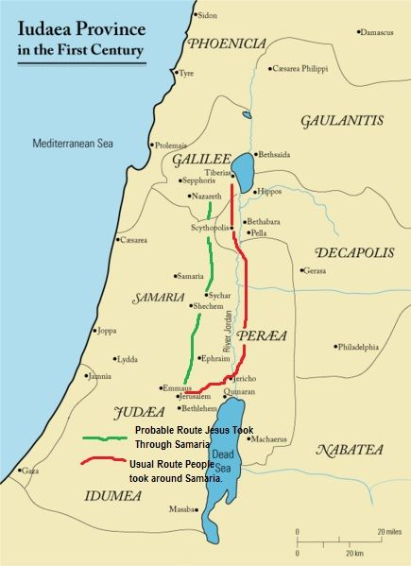
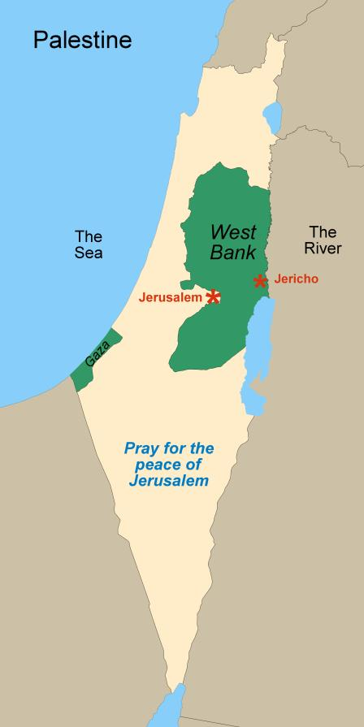
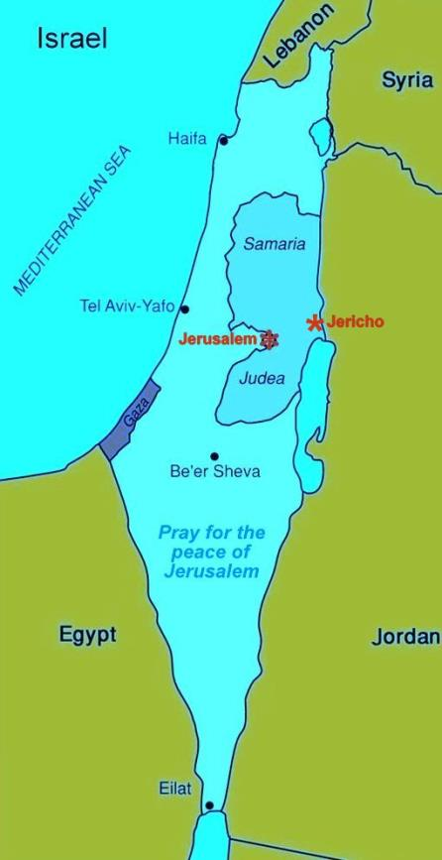

Slide 21
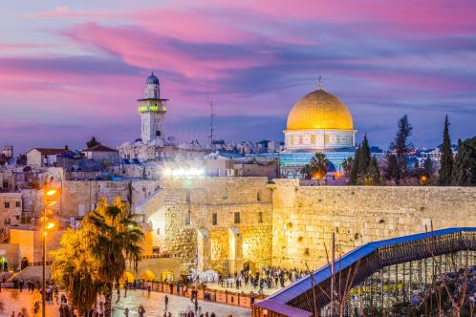
The centrality of Jerusalem
Thus says the Lord Yahweh: “This is Jerusalem. I have set her in the center of the nations, with countries all around her.”
Ezekiel 5:5
“O Jerusalem, Jerusalem, the city that kills the prophets and stones those who are sent to it! How often would I have gathered your children together as a hen gathers her brood under her wings, and you were not willing!”
Matthew 23:37

Slide 22
The Essential Nature of Faith
Trust in the Lord with all your heart, and do not lean on your own understanding. In all your ways acknowledge him, and he will make straight your paths. Be not wise in your own eyes; fear the Lord, and turn away from evil. It will be healing to your flesh and refreshment to your bones.
Proverbs 3:5-8
For by grace you have been saved through faith. And this is not your own doing; it is the gift of God, not a result of works, so that no one may boast. For we are his workmanship, created in Christ Jesus for good works, which God prepared beforehand, that we should walk in them.
Ephesians 2:8-10

Slide 23
The Promises and Power of Hope
Blessed be the God and Father of our Lord Jesus Christ! According to his great mercy, he has caused us to be born again to a living hope through the resurrection of Jesus Christ from the dead.
1 Peter 1:3
For God so loved the world, that he gave his only Son, that whoever believes in Him should not perish but have eternal life.
John 3:16
Let us fix our eyes on Jesus, the author and perfecter of our faith, who for the joy set before Him endured the cross, scorning its shame, and sat down at the right hand of the throne of God.
Hebrews 12:2
May the God of hope fill you with all joy and peace in believing, so that by the power of the Holy Spirit you may abound in hope.
Romans 15:13

Slide 24
Priorities C: All in One
Jesus said to him, “I am the way, and the truth, and the life. No one comes to the Father except through me. If you had known me, you would have known my Father also. From now on you do know him and have seen him.”
John 14:6-7
But he [Jesus] was pierced for our transgressions; he was crushed for our iniquities; upon him was the chastisement that brought us peace, and with his wounds we are healed. All we like sheep have gone astray; we have turned – every one – to his own way; and the Lord has laid on him the iniquity of us all.
Isaiah 53:5-6
God is not man, that he should lie, or a son of man, that he should change his mind. Has he said, and will he not do it? Or has he spoken, and will he not fulfill it?
Numbers 23:19
Note: Father and Lord are both Yahweh

Slide 25
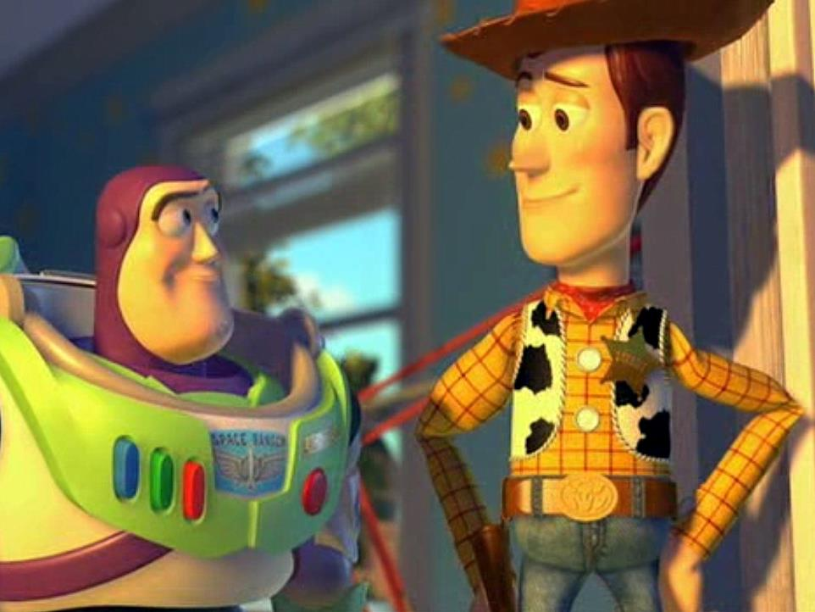

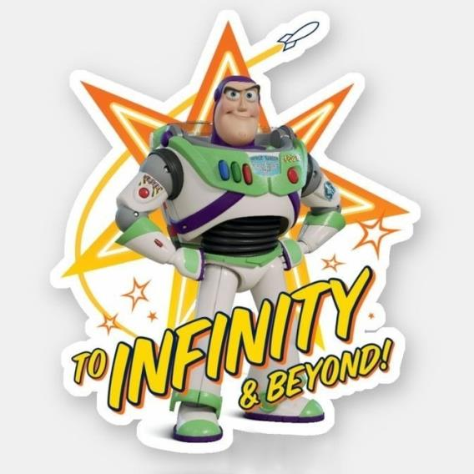

Slide 26
2.
Worldview/ Ideology Matter
What’s your worldview?

Slide 27
RELIGIOUS IDENTITIES OF
THREE GLOBAL BELIEF SYSTEMS
1.
Judeo-Christian
Includes varied teachings of all branches of Judaism, Roman Catholic, Maronite, Eastern / Russian Orthodox, and all denominations of Protestantism.
2.
Islam, Hinduism
Includes Sunni, Shia and other sects of Islam, Bah’ai, and various forms of Hindusim / Buddhism and tribal religions in North Africa, the Middle East, and the Indian subcontinent.
3.
Atheistic/Nones
Includes secular humanism, progressive socialism, Marxism, and Chinese and Russian Communism, especially when these implicitly or explicitly marginalize or discriminate against religious expression.

Slide 28
CORE IDEOLOGIES OF
THREE GLOBAL BELIEF Systems
1.
Judeo-Christian
God is Yahweh, the God of Abraham, Isaac, Jacob (Israel). Father, Son, and Holy Spirit.
Christians honor Jesus as Messiah.
Sacrificial Love
Transformaton
Truth is in God and His Word, the Bible.
2.
Islam + Hindu / Buddha
God is Allah of Mecca, claimed to be from Abraham and Ishmael. Others polytheistic with heirarchies of gods.
Prophet Mohammed with Jesus, etc lower.
Domination and Rage
Submission
Truth is in Allah, the Qur’an + holy books.
3.
Atheistic/Nones
Materialism only, no mythical human “God.” The sole authorities
over humanity are the self and the state.
Jesus said some good things as a man.
Pride and Power
Revolution
Truth is psychosocially determined by self/state.

Slide 29

Grafted into the Vine
“I am the vine; you are the branches. Whoever abides in Me and I in him, he it is that bears much fruit, for apart from Me you can do nothing.”
John 15:5
I can do all things through him who strengthens me.
Philippians 4:13

Slide 30

A Time for Everything
For everything there is a season, and a time for every matter under heaven: a time to be born, and a time to die; a time to plant, and a time to pluck up what is planted; a time to kill, and a time to heal; time to break down, and a time to build up; a time to weep, and a time to laugh; a time to mourn, and a time to dance; a time to cast away stones, and a time to gather stones together; a time to embrace, and a time to refrain from embracing; a time to seek, and a time to lose; a time to keep, and a time to cast away; a time to tear, and a time to sew; a time to keep silence, and a time to speak; a time to love, and a time to hate; a time for war, and a time for peace.
Ecclesiastes 3:1-8

Slide 31
3.
Hopes for the
Future Matter
Eschatology: What are you praying for?

Slide 32
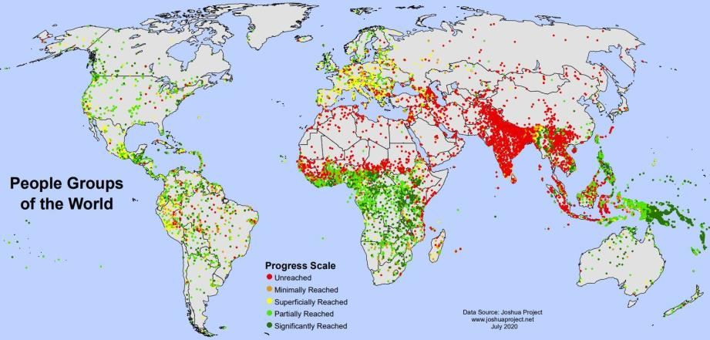







MAPS
?
?
?
?
___________>
Christian
Marxist
Islamic
Hindu
The 10/40 Window is located from 10 to 40 degrees north of the equator across northern Africa,
the Middle East, and Central Asia. 69 nations with nearly 4 billion people live here,
including 90 percent of the world's poorest of the poor.
Note Communist, Islamic, and Hindu affiliations concentrated in unreached areas

Slide 33
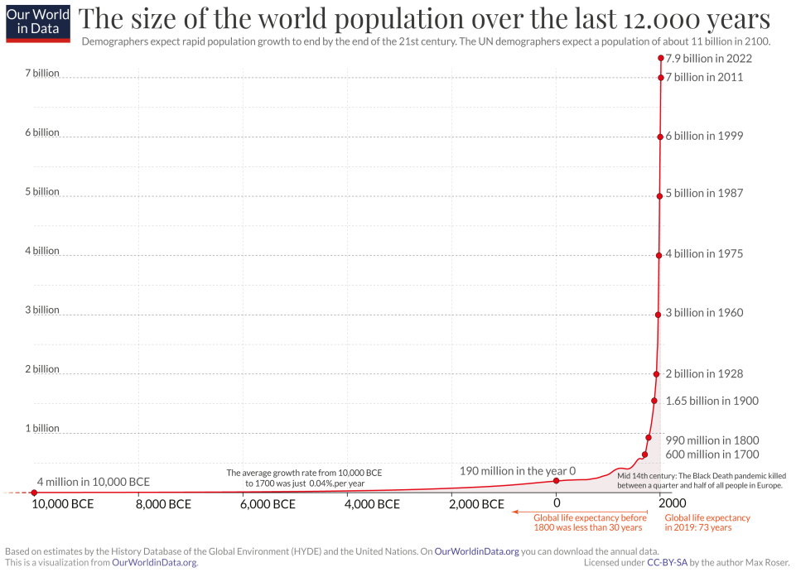
,
Enlightenment
Progressivism
Modernity
Darwin
Marx
Global population prior to Christ was less than 190 million
The first god to appear in Greek/Roman mythology is Chaos, who represented the void. Chaos gave birth to two children, the Night and Darkness. They in turn gave birth to Light and Day.
Then I said, “O my lord, what shall be the outcome of these things?” He said, “Go your way, Daniel, for the words are shut up and sealed until the time of the end. Many shall purify themselves and make themselves white and be refined, but the wicked shall act wickedly. And none of the wicked shall understand, but those who are wise shall understand.” Daniel 12:8-10
Confucius
Kukulkan+
Tengri+
Hindu+
Buddha
Shiva
Ra+
Shangdi+
Incas+
Zeus+
Allah
Mohammed
Abraham
Ezekiel
David
Jesus
Adam
Noah
Jacob
Moses
500
1000
Visualization drawn from data available on OurWorldinData.org

Slide 34




Ultimate Futures Envisioned by Major Global Belief Systems
Atheistic / Nones – The state progressively establishes a godless (?) materialistic controlled utopia with regulated happiness promised for all.
Islam – Establishment of a worldwide caliphate with victorious Sharia Law under Allah of Mecca and
elimination of all infidels.
Hinduism / Buddhism – Birth and rebirth, building up and destruction, in endless cycles under a host of gods,
some foremost.
Judeo-Christian – Worsening cycles of worldwide tribulation, culminated by apocalyptic return of Christ and establishment
of a Millennial Kingdom of God leading to Heaven.

Slide 35
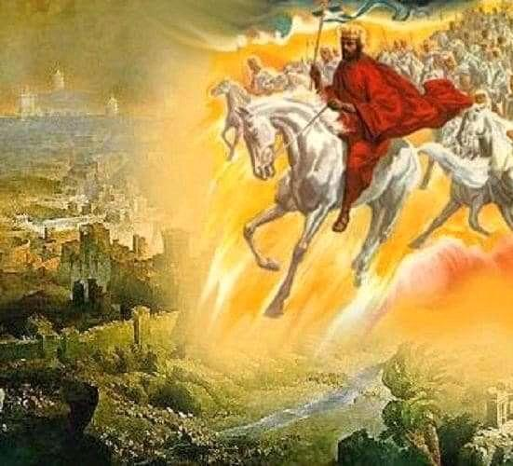
THE LION
OF JUDAH RETURNING
AT THE CLOSE OF THE AGE

Slide 36
NEW & old resourceS
The Daily News
Empowered Witness:
Politics, Culture, and the Spiritual Mission of the Church
Alan D. Strange, PhD (2024)
1984 by Orwell (1949), Island by Huxley (1962),
The Wanting Seed by Anthony Burgess (1962)
The Unseen Realm:
Recovering the Supernatural Worldview of the Bible
Michael S. Heiser, Lexham Press (2015)
The ESV Study Bible
Daily Devotions & Prayer

Slide 37
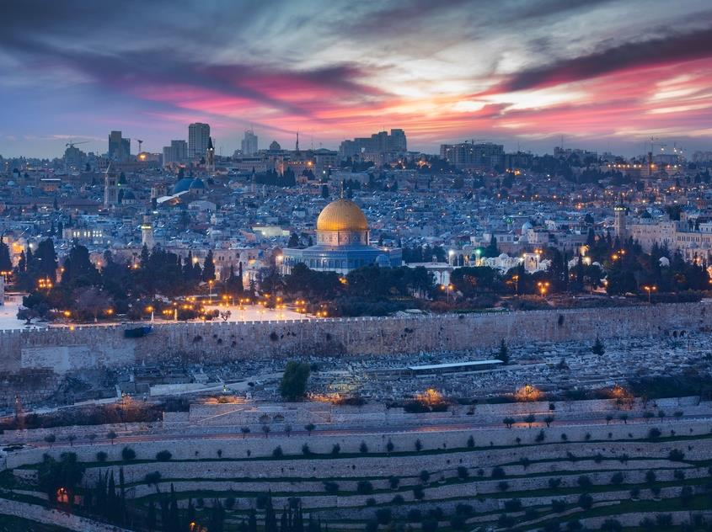

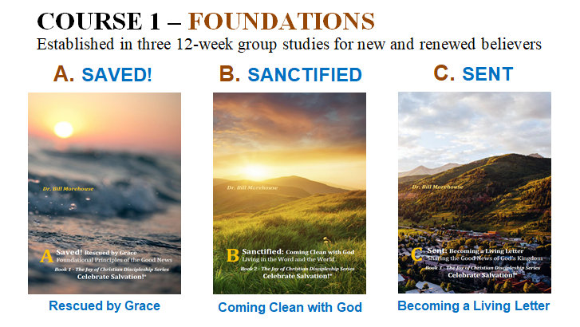
  Celebrate Salvation!
Being born again, pursuing God’s Kingdom and His righteousness, and sharing with others

Slide 38
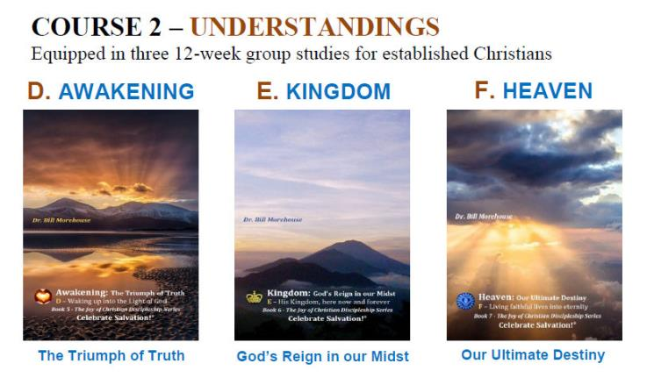
  Celebrate Salvation!
Being awakened in community, living in God’s Kingdom, and envisioning our ultimate destiny

