Slide 2
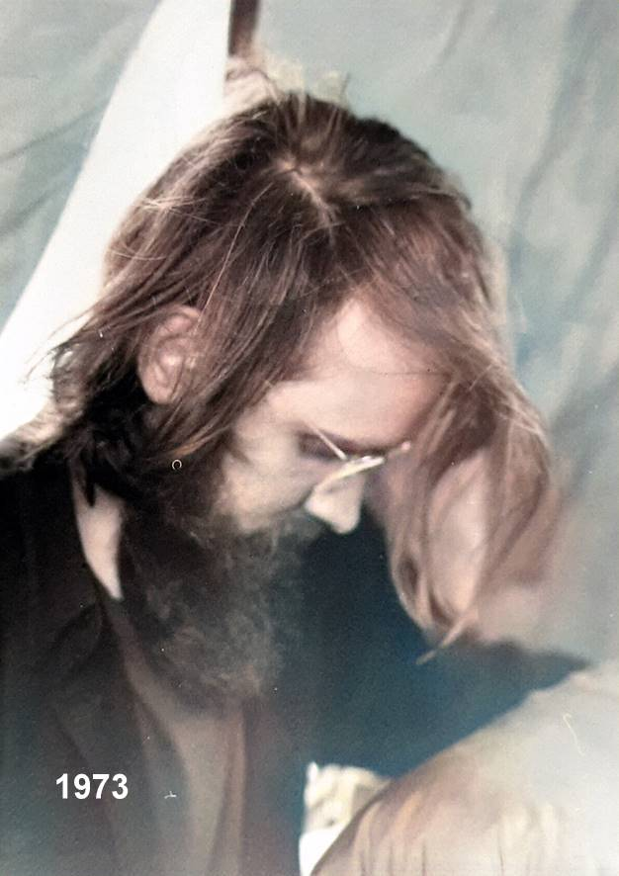
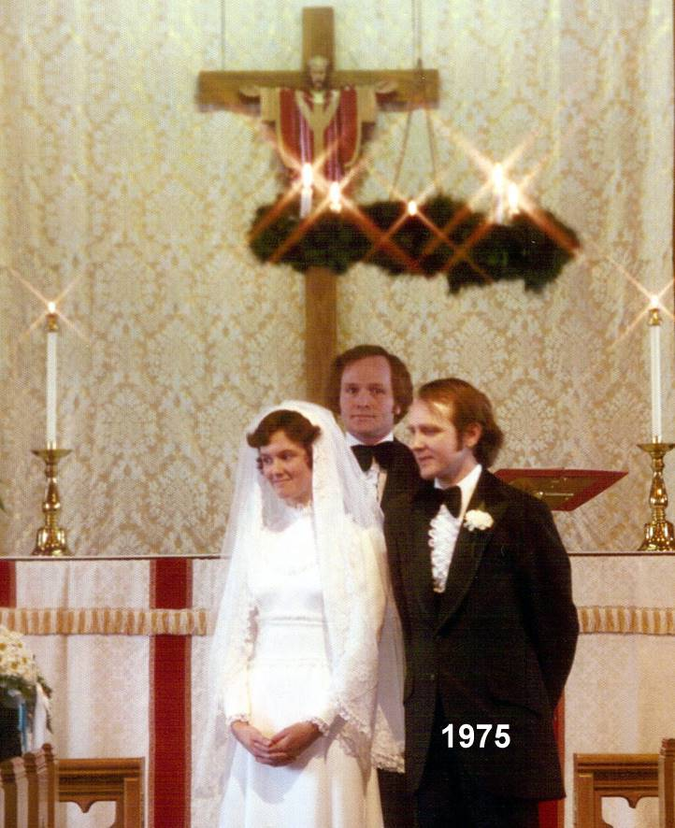
Salvation Here Now and for All Eternity!

Slide 4
Blessed are those who hunger and thirst for righteousness, for they shall be satisfied.
Jesus in Beatitudes, Matthew 5:6

Slide 5
It is written, “Man shall not live by bread alone, but by every word that comes from the mouth of God.”
Jesus in Matthew 4:4 (see Deuteronomy 8:3)

Slide 6
Whoever would draw near to God must believe that he exists and that he rewards those who seek him.
Hebrews 11:6

Slide 7
He has put eternity into man’s heart and has made everything beautiful in its time.
Solomon in Ecclesiastes 3:11

Slide 8
THE GREAT COMMANDMENTS
J
O
Y
?
“Teacher, which is the great commandment in the Law?” And He said to him, “You shall love the Lord your God with all your heart and with all your soul and with all your mind. This is the great and first commandment. And the second is like it: You shall love your neighbor as yourself. On these two commandments depend all the Law and the Prophets.”
Matthew 22:36–40

Slide 9
1.
HOW?
How do we hunger and thirst the
way we do?

Slide 10
IT STARTS AT BIRTH
When we’re newborn babies, people expect us to cry. It’s a sign that we’re alive and have real feelings. We’re uncomfortable and want attention in some way – in pain or cold or thirsty or hungry or lonely… We don’t quite know what it is but somebody will hear us who knows and will come figure it out, take action, and let us know by what they say and do what our problem is. After a while we become able to identify and understand our own needs and sensations enough that we can we can ask for help “using our own words” or go about trying to meet them ourselves. We’re growing up!

Slide 11
SOMETIME LATER ON
As we grow older we become aware of other yearnings – to know what’s going on, where we fit in, what to do next, what’s the right thing to think or do or say. We develop questions about what happens when people die, what religion is all about, why people act the way they do. We hunger for understanding and to be understood. We ache for acceptance, relationship, safety and security, and to know what genuine love is. Is there really a God and, if so, what is this “god” all about? Whether we know it or not, we’ve begun our own journey of asking, seeking, and knocking in hopes of being satisfied with truth in what we end up finding.

Slide 12
2. WHY?
Why do we hunger and thirst?

Slide 13
IT’S ACTUALLY PRETTY SIMPLE
God made us in His Image with built-in desires and needs for spiritual, personal, physical and nurture that need to be filled for our lives to continue and prosper.
There are lots of ways to try to fill these needs, some of which are helpful and pure and others which are counterproductive and polluted, and we need to learn how to make wise choices.
Fortunately, God has given us the ability to sense that something is missing and learn how to identify what is actually needed.

Slide 14
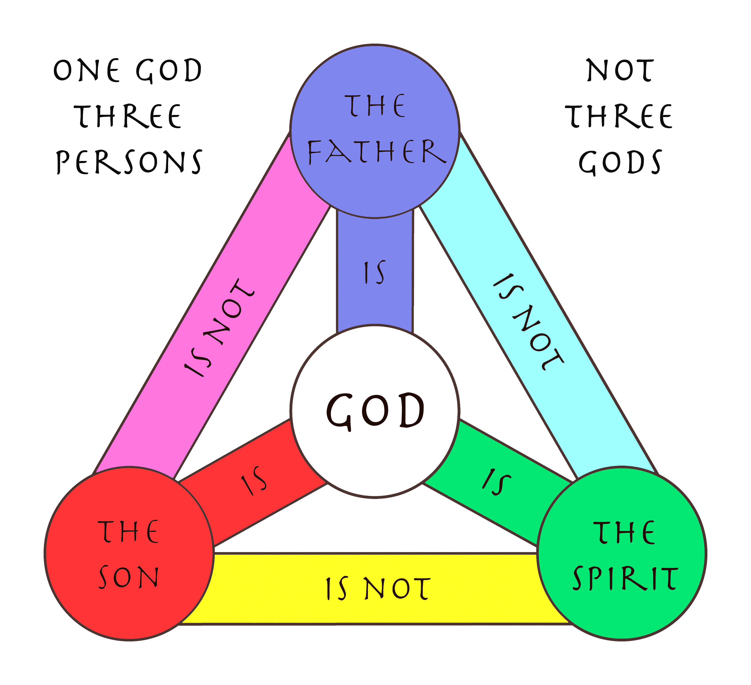
GOD’S IMAGE IN THE TRINITY
Hallelu Jah!
Yahweh or Jehovah
YHWH
Ruach
Hakodesh
Yeshua
GOD IN THREE PERSONS

Slide 15
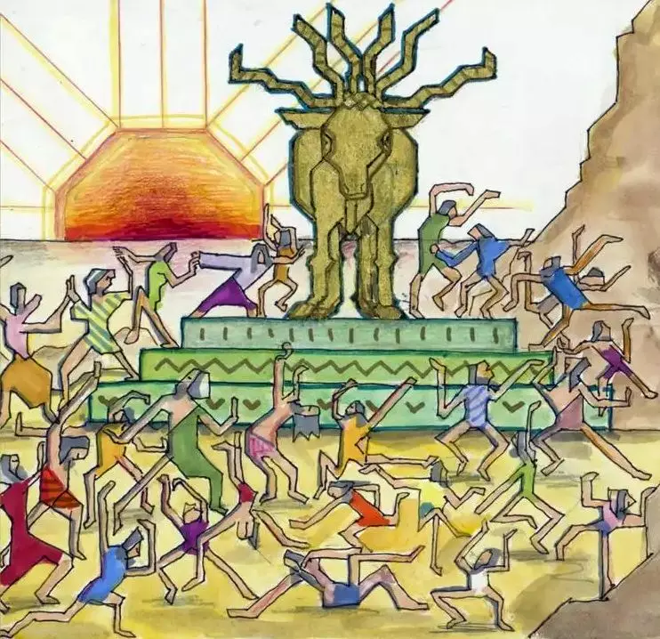
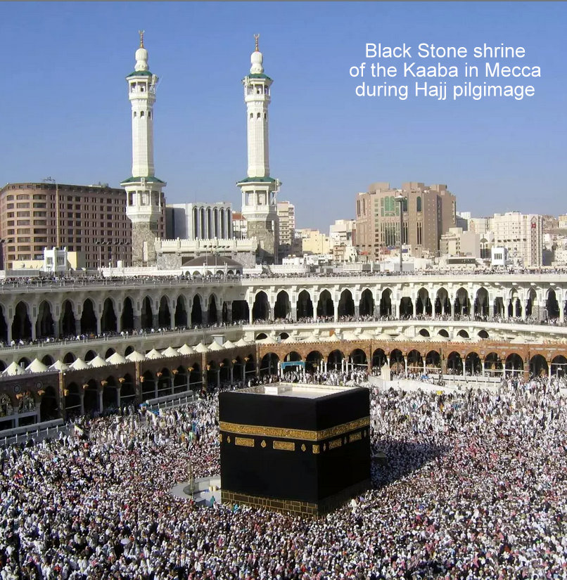
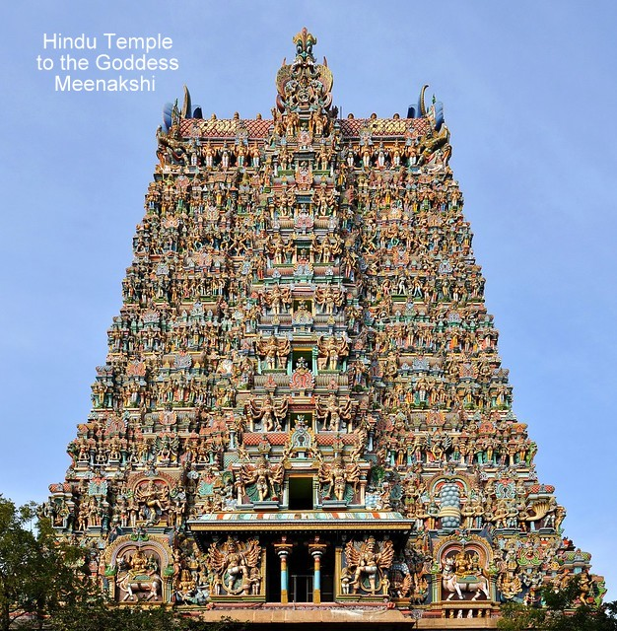
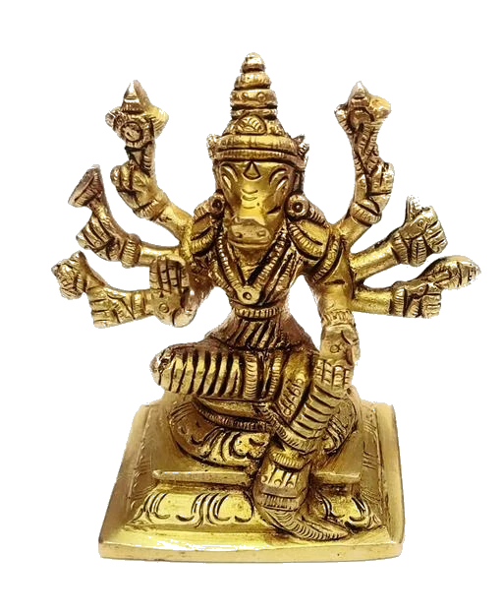
What OTHER GODS?
And God spoke all these words, saying,
“I am the Lord your God, who brought you out of the land of Egypt, out of the house of slavery. You shall have no other gods before me.”
Exodus 20:1-3
Let’s get beyond Pride, Self, Money, and Power... how about the named spiritual false gods like Ra, Baal, Thor, Allah, Vishnu, Krishna, Brahma, Meenakshi, Shangdi, etc.?

Slide 16
GOD’S IMAGE IN HUMANITY
Now may the God of peace himself sanctify you completely, and may your whole spirit and soul and body be kept blameless at the coming of our Lord Jesus Christ. 1 Thessalonians 5:23
SPIRIT
Ruach רוּחַ))
Pneumo
Agency
SOUL
Nephesh (נֶפֶשׁ)
Psyche
Identity
BODY
Basar בָּשָׂרַ))
Soma
Activity
OUR TRIPARTITE NATURE

Slide 17
NURTURE NEEDED IN ALL 3 AREAS
spiritual
Air – Faith, life, gifts and grace, visions and dreams
Water – Love, comfort, meaning
Food – Hope, Word of God, discernment,
guidance, revelation
Personal
Air – Identity, affirmation, family, honor, respect
Water – Place in society, community
Food – Purpose, help, teamwork, humility, wisdom
physical
Air – Ventilation, O2, waste removal
Water – Hydration, cleansing, plant and animal life
Food – Energy, growth, activity, reproduction

Slide 18
Trust in the Lord with all your heart, and do not lean on your own understanding.
In all your ways acknowledge him, and he will make straight your paths.
Proverbs 3:5-6

Slide 19
If any of you lacks wisdom, let him ask God, who gives generously to all without reproach, and it will be given him.
James 1:5

Slide 20
3. WHERE?
Behold, you delight in truth in the inward being, and you teach me wisdom in the secret heart.
Psalm 51:6

Slide 21
WHERE ARE WE AND GOD?
The God who made the world and everything in it, being Lord of heaven and earth, does not live in temples made by man, nor is he served by human hands, as though he needed anything, since he himself gives to all mankind life, and breath, and everything.
And he made from one man every nation of mankind to live on all the face of the earth, having determined allotted periods and the boundaries of their dwelling place, that they should seek God, and perhaps feel their way toward him and find him.
Yet he is actually not far from each one of us, for in him we live and move and have our being. _{Acts 17:24-28}

Slide 22
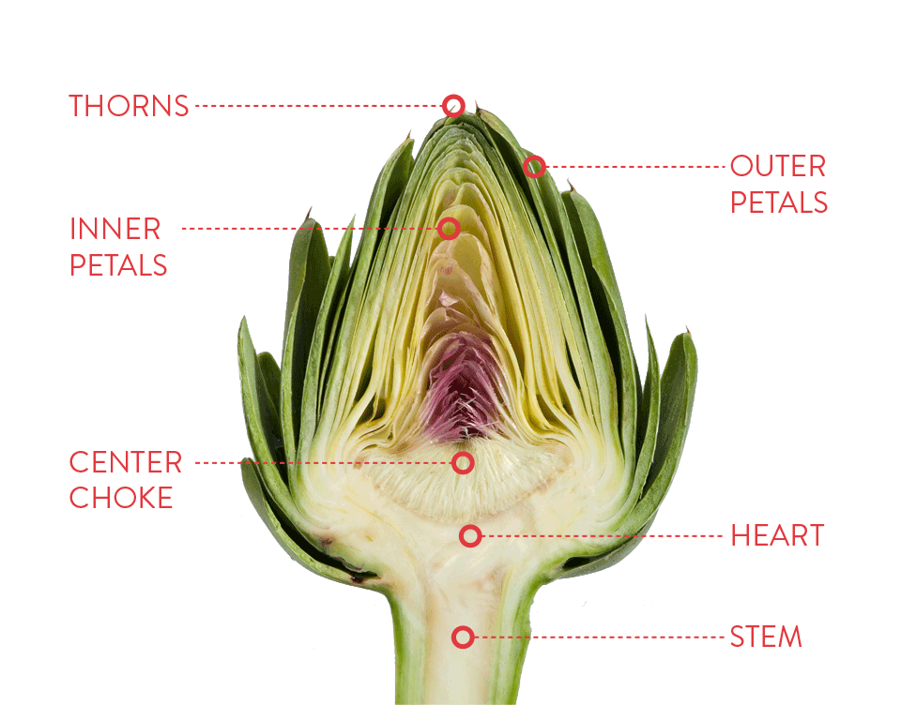

Slide 23
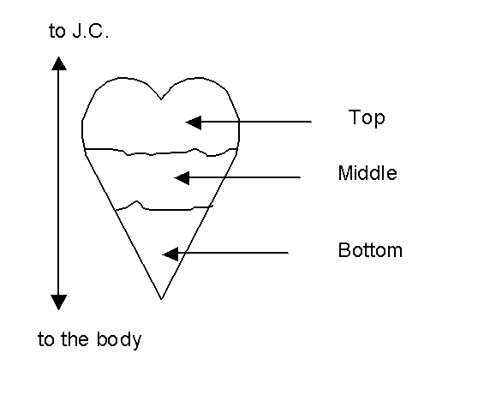
What’s on your heart?
Flow of stress or unresolved conflict
Naturally downward, supernaturally upward
to the world
Our innermost being
to the body
Genuine spiritual life usually flows upward from the bottom of our hearts.
Top – “Conscious” mind – external sensory input, current activities and thoughts, more superficial, public information easily shared with others.
Middle – “Subconscious” mind – just below the conscious but accessible, more personal and private, going on in the background, associated with feelings and emotions.
Bottom – “Unconscious” realm – deeper than subconscious and sometimes hard to access, most personal and enduring, enriched with past memories and experiences, very visceral, underlies all.
This is the primary place where we connect across to God spiritually.

Slide 24
Why are you cast down, O my soul, and why are you in turmoil within me? Hope in God!
David in Psalm 43:5

Slide 25
Whoever drinks of the water that I will give him will never be thirsty again. The water that I will give him will become in him a spring of water welling up to eternal life.
Jesus in John 4:14

Slide 26
THE WOMAN AT THE WELL
Jesus said to her, “Woman, believe me, the hour is coming when neither on this mountain nor in Jerusalem will you worship the Father. You worship what you do not know; we worship what we know, for salvation is from the Jews. But the hour is coming, and is now here, when the true worshipers will worship the Father in spirit and truth, for the Father is seeking such people to worship him. God is spirit, and those who worship him must worship in spirit and truth.”
The woman said to him, “I know that Messiah is coming (he who is called Christ). When he comes, he will tell us all things.” Jesus said to her, “I who speak to you am he.” _{John 4:21-26}

Slide 27
WHO KNOWS THE THOUGHTS?
The spirit of man is the lamp of the Lord, searching all his innermost parts. _{Proverbs 20:27}
For who knows a person’s thoughts except the spirit of that person, which is in him? So also no one comprehends the thoughts of God except the Spirit of God. Now we have received not the spirit of the world, but the Spirit who is from God, that we might understand the things freely given us by God… “For who has understood the mind of the Lord so as to instruct him?” But we have the mind of Christ. _{1 Corinthians 2:11-16}

Slide 28
WHO KNOWS THE THOUGHTS?
A quiet struggle for our attention goes on deep in our hearts.
The World: The incessant sensory distractions and demands of the world around us compete for out attention and loyalty.
The Flesh: Our human urges, lusts, desires, feelings and pride, especially having to do with sex, money, power and prestige.
The Devil: Deceptions, rationalizations, grievances, victimhood, principalities and powers that promulgate false gospels and ideologies to compete with God’s Word.
The gentle voice of God coming, quite apart from all the other competing voices, through a door even deeper within us.

Slide 29
SORTING OUT OUR THOUGHTS
For the Word of God is living and active, sharper than any two-edged sword, piercing to the division of soul and of spirit, of joints and of marrow, and discerning the thoughts and intentions of the heart. _{Hebrews 4:12}
The weapons of our warfare are not of the flesh but have divine power to destroy strongholds. We destroy arguments and every lofty opinion raised against the knowledge of God, and take every thought captive to obey Christ. _{2 Corinthians 10:4-5}

Slide 30
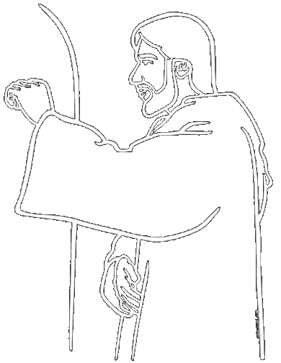
Ask, and it will be given to you; seek, and you will find; knock, and it will be opened to you. For everyone who asks receives, and the one who seeks finds, and to the one who knocks it will be opened. Matthew 7:7
Behold, I stand at the door and knock. If anyone hears my voice and opens the door, I will come in to him and eat with him, and he with me.
_{Revelation 3:20}
THE DOOR
US THE DOOR TO THE FATHER
EARTH HEAVEN
Recommendation: Open the door and let Him in then leave it open, listen, and follow Him!

Slide 31
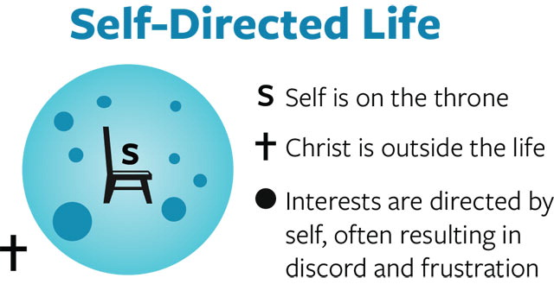
Trust in the Lord
Conversion from
Self as lord
to Christ as Lord
and lean not to
your own understanding

Slide 32
HOW THE BRAIN WORKS
LEFT BRAIN
The Law, Logos
Systematic theology
Catechisms and Creeds
Organized Religion
Ideas and Ideologies
Rationalization
Math and Science
Systems and Structures
Memorization
Inborn Talents
RIGHT BRAIN
The Prophets, Rhema
Faith, Hope, and Love
Dreams and Visions
Relationships
Integrated Perspective
Insight and Revelation
Art, Music, and Poetry
Dynamic Interactions
Discernment
Spiritual Gifts
Always best when synchronized!

Slide 33
WHO’S IN CHARGE?
Those who are dominated by the sinful nature think about sinful things, but those who are controlled by the Holy Spirit think about things that please the Spirit. So letting your sinful nature control your mind leads to death. But letting the Spirit control your mind leads to life and peace. _{Romans 8:5-6 NLT}
Trust in the Lord with all your heart, and do not lean on your own understanding. In all your ways acknowledge him, and he will make straight your paths. _{Proverbs 3:5-6}

Slide 34
ARE YOU OR JESUS IN CHARGE?

Slide 35
4. FOR WHAT?
THE HARVEST!

Slide 36
Our Father in heaven, hallowed be your name. Your kingdom come, your will be done, on earth as it is in heaven.
The Lord’s Prayer

Slide 37
The harvest is plentiful, but the laborers are few; therefore pray earnestly to the Lord of the harvest to send out laborers into his harvest.
Jesus in Matthew 37-38

Slide 38
The Spirit and the Bride say, “Come.” And let the one who hears say, “Come.” And let the one who is thirsty come; let the one who desires take the water of life without price.
Jesus in Revelation 22:17

Slide 39
He who testifies to these things says, “Surely I am coming soon.” Amen. Come, Lord Jesus!
Jesus in Revelation 22:20 (~96 AD)
COME LORD JESUS!

Slide 40
THE LION OF JUDAH AT THE CLOSE OF THE AGE!

Slide 41
NEW & old resourceS
The Daily News
Supernatural or The Unseen Realm:
Recovering the Supernatural Worldview of the Bible
Michael S. Heiser, Lexham Press, 2015
The Harvest Just Ahead:
Developing a Life of Absolute Commitment
Derek Prince, available as PDF online, 1974
The ESV Study Bible plus NJB or WEB
Lane Dennis, et al., 2016 plus ebible.org/web
Daily Devotions & Prayer

Slide 42
? QUESTIONS
Dr. Bill Morehouse
Visit me at:
HisKingdom.us
wmorehouse.com
celebratesalvation.org
Or contact me at:
wmorehouse@gmail.com
Mobile (585) 314-1144
Go deep in Bible study, prayer, Google

Slide 43
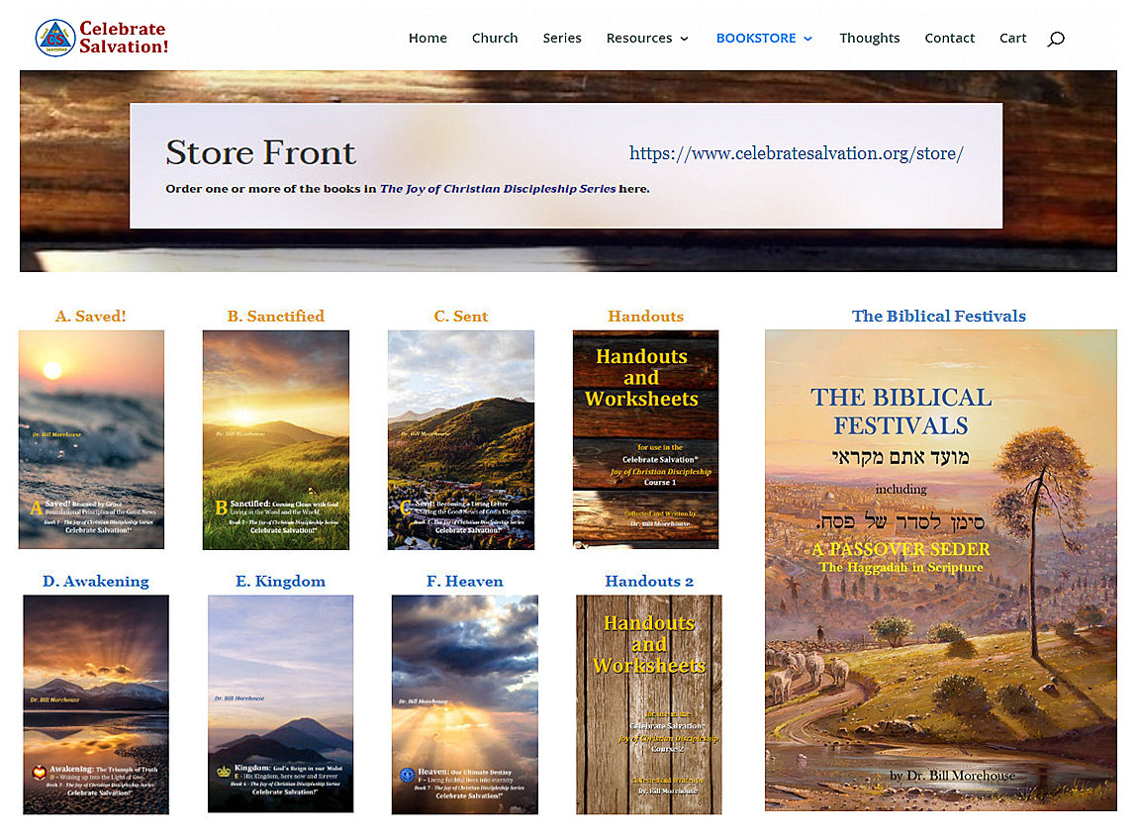
celebratesalvation.org web and HIS KINGDOM PRESS BOOKTABLE
Course 1
Course 2
and
Biblical
Festivals

