Slide 1
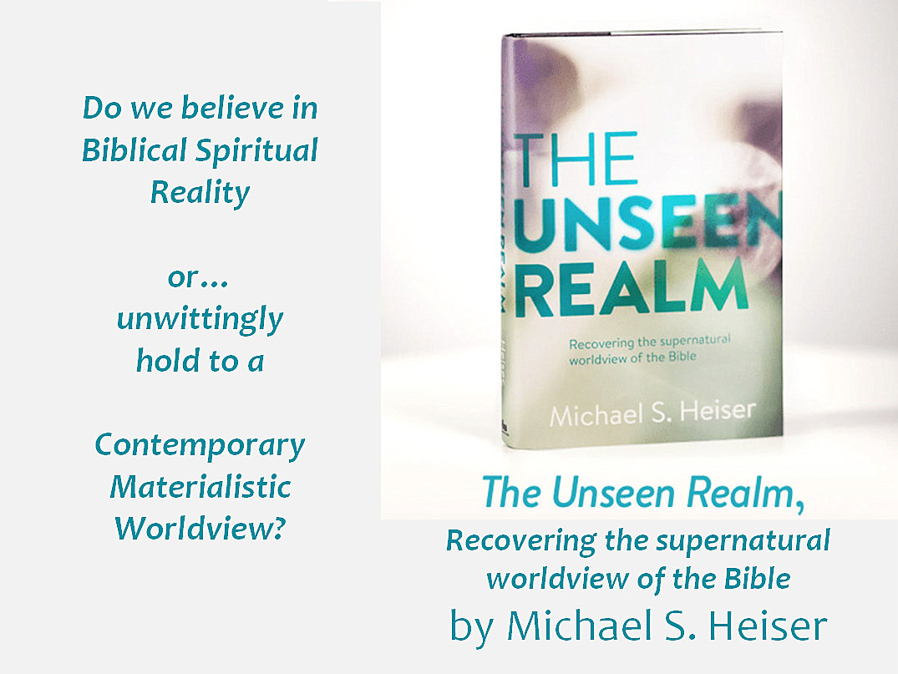
How do we integrate sensory input?
Seeing Eyeball, optic nerve, brain, mind
Hearing Ear, auditory nerve, brain, mind
Understanding Information, concepts, framework, insight, revelation
For who knows a person’s thoughts except the spirit of that person, which is in him? 1 Corinthians 2:11
My eyes Myopia, cataracts, glasses, surgery
My ears Noise damage, hearing aids
My brain, mind Broad vision, small details

Slide 2
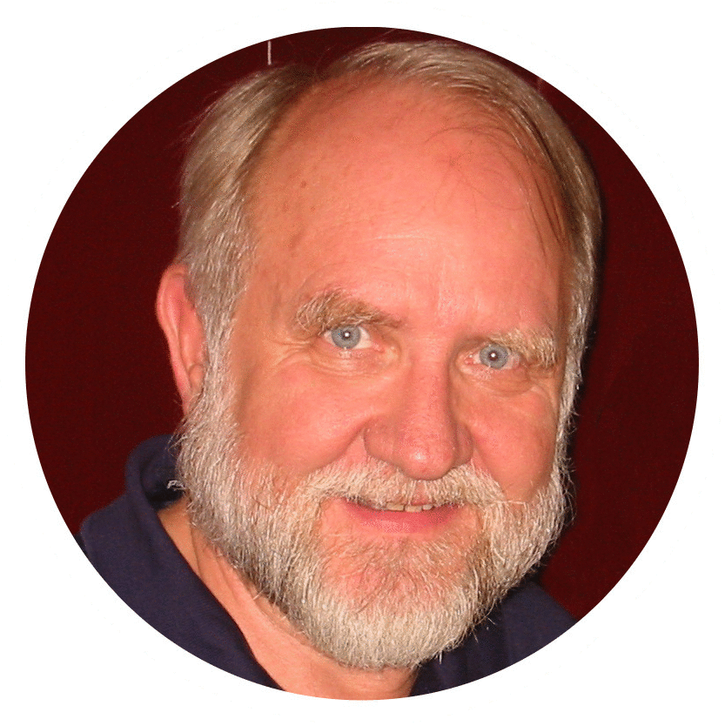
Love,
Light,
and Life
A Memorial Acclamation
The Lamb of God
Christ was born;
Christ has died;
Christ is risen!
Christ will come again.
The Lion of Judah
Bill Morehouse
MERRY
ORTHODOX
CHRISTMAS! Men’s Bible Study January 4, 2024
and a
HAPPY
NEW YEAR! Men’s Bible Study January 4, 2024

Slide 3
QUESTIONS:
Who is this God?
A Concept or Reality?
What’s the Context
> in history?
> in the Bible?
> in our lives?
A God of
Love,
Light,
& Life?
In our MBS what we seek to learn is the truth,
the whole truth, and nothing but the truth.

Slide 4
Why do the nations rage and the peoples plot in vain? The kings of the earth set themselves, and the rulers take counsel together, against the Lord and against his Anointed, saying, “Let us burst their bonds apart and cast away their cords from us.”
He who sits in the heavens laughs; the Lord holds them in derision. Then he will speak to them in his wrath, and terrify them in his fury, saying, “As for me, I have set my King on Zion, my holy hill.” _{Psalm 2:1-4}

Slide 5
First you forget names,
then you forget faces.
Next you forget to pull your zipper up
and finally, you forget to pull it down.
George Burns

Slide 6
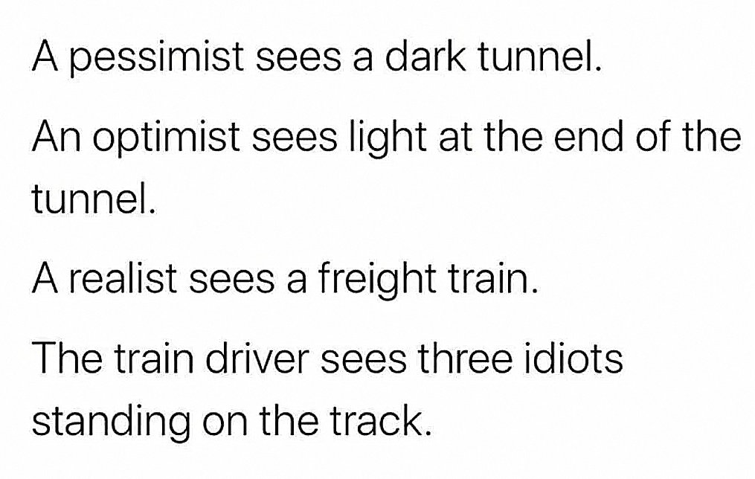
I forget some names and try to forget others.
Some faces are more forgettable than others.
As for my zipper, my wife keeps an eye on it.
I still make it to the toilet when it’s time.
Garrison Keillor

Slide 7
For God so loved the world, that he gave his only Son, that whoever believes in him should not perish but have eternal life… God is love. John 3:16, 1 John 4:16
In the beginning was the Word, and the Word was with God, and the Word was God. In him was life, and the life was the light of men. The light shines in the darkness, and the darkness has not overcome it.
John 1:1, 4-5
I am the resurrection and the life. Whoever believes in me, though he die, yet shall he live, and everyone who lives and believes in me shall never die. John 11:25-26

Slide 8
GOD-SIZED PROBLEMS
= GOD-SIZED OPPORTUNITIES

Slide 9
Put on the whole armor of God, that you may be able to stand against the schemes of the devil. For we do not wrestle against flesh and blood, but against the rulers, against the authorities, against the cosmic powers over this present darkness, against the spiritual forces of evil in the heavenly places. Therefore take up the whole armor of God, that you may be able to withstand in the evil day, and having done all, to stand firm.
Ephesians 6:11-12

Slide 10
*Ἰουδαίων = “ioudaios” – Jewish, one sprung from the tribe of Judah
or a subject of the kingdom of Judah; a descendant of Jacob.
“Salvation is from the Jews.* But the hour is coming and is now here, when true worshipers will worship the Father in spirit and truth, for the Father is seeking such people to worship him. God is spirit, and those who worship him must worship in spirit and truth.” The woman said to him, “I know that Messiah is coming (he who is called Christ). When he comes, he will tell us all things.” Jesus said to her, “I who speak to you am he.”
John 4:22-26
The book of the genealogy of Jesus Christ, the son of David, the son of Abraham. Abraham was the father of Isaac, and Isaac the father of Jacob, and Jacob the father of Judah* and his brothers...
Matthew 1:1-2

Slide 11
And many of those who sleep in the dust of the earth shall awake, some to everlasting life, and some to shame and everlasting contempt. And those who are wise shall shine like the brightness of the sky above; and those who turn many to righteousness, like the stars forever and ever. But you, Daniel, shut up the words and seal the book, until the time of the end. Many shall run to and fro, and knowledge shall increase.
Daniel 12:2-4

Slide 12
TWO LEVELS OF GRACE
Common Grace
Given freely for the asking to all of mankind, regardless of belief, behavior, or faith commitment.
Examples: Affection, provision, wisdom, desire for a good life, hope of eternity.
Special Revelation
Available by the power of God’s Holy Spirit to those who love Yahweh and who seek understanding through His Son, His Word, and prayer.
Includes: Saving faith and revelation.

Slide 13
GOD-SIZED PROBLEMS IN THREE REALMS
1.
Self, Individual
Look in the mirror.
Who do you see?
Are we able to solve our problems all by ourselves?
The older we get, the more we begin to understand how deeply flawed and imperfect we are.
2.
Family, Associates
Relationships with our fellow believers and our extended family members, as well as our friends and neighbors, school and work associates, public servants and citizens. All of us need His help every day.
3.
World, Society
Village, town, city, community, county,
state, nation.
Group, association, corporation, school, political party, sect.
Religion, race, gender, ideology.
What does the future hold, and where to we fit?

Slide 14
1.
Self, Individual
What baggage are we each carrying?
Can our problems really be fixed apart from God?

Slide 15
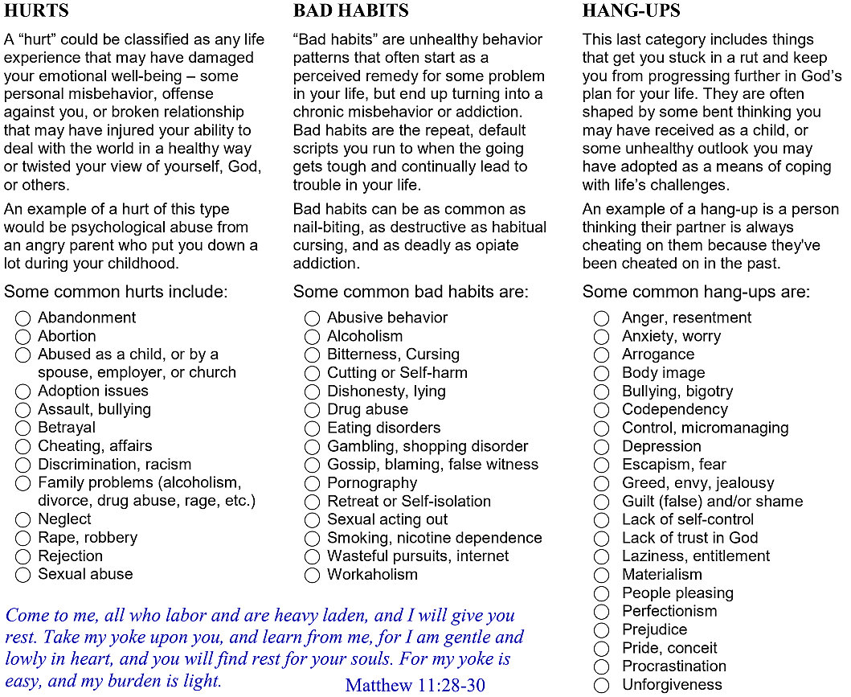
Learning to love God and be
loved by Him into wholeness is the prerequisite for loving our neighbors as ourselves.

Slide 16
2. Family, Associates
What about problems within our families, communities, work associates, and “7 Spheres” institutions?

Slide 17
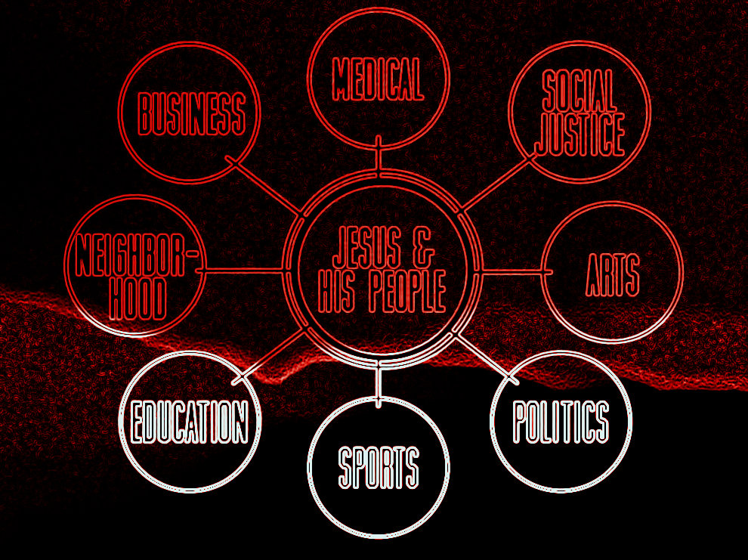
Wisdom cries aloud in
the streets, in the markets she raises her voice: Love your neighbors as yourselves!

Slide 18
3. World, Society
We’re in a confused and troubled world. Where will it all end? And how can we be overcomers?

Slide 19
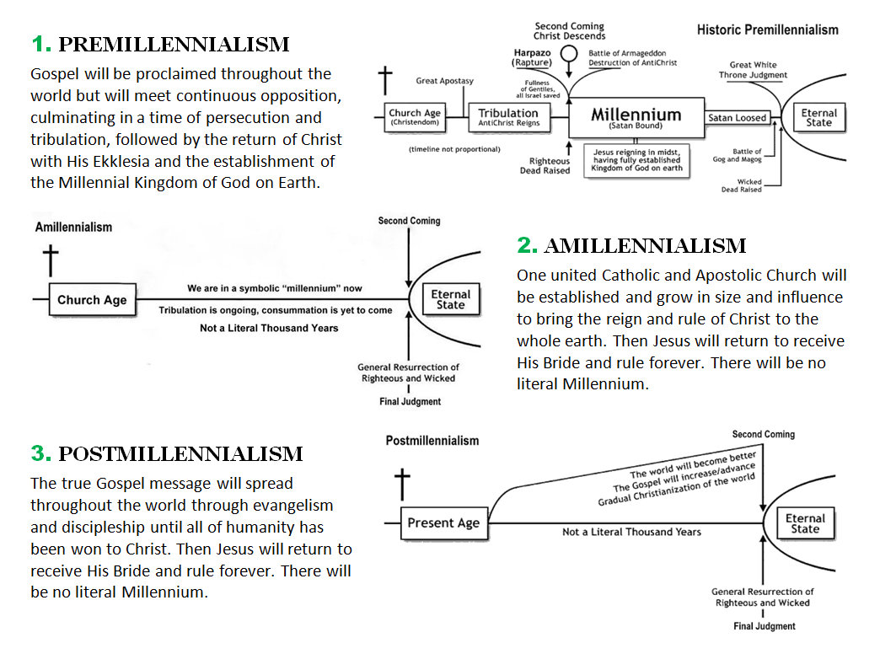
Pray for the peace of Jerusalem! May they be secure who love you! And may peace be within your walls!

Slide 20
GOD-SIZED PROBLEMS IN ALL THREE REALMS
Where should our priorities lie in solving our problems, Faith in God or Faith in Politics?
1. Faith in Man and His Politics
Democrats vs. Republicans
Liberal vs. Conservative
Revolution vs. Evolution
2. Faith in God and His Word
Living Word of God
Biblical worldview
Trusting in God and His Wisdom
1. Faith in God and His Word
Biblical worldview
Living Word of God
Trusting in God and His Wisdom
2. Faith in Man and His Politics
Democrats vs. Republicans
Liberal vs. Conservative
Revolution vs. Evolution

Slide 21
GOD-SIZED PROBLEMS IN ALL THREE REALMS
Where should our priorities lie in solving our problems, Faith in God or Faith in Politics?
“The first thing to be said about public life is that public life is not the first thing. Religion that is captive to public life is of little public use.”
Richard John Neuhaus

Slide 22
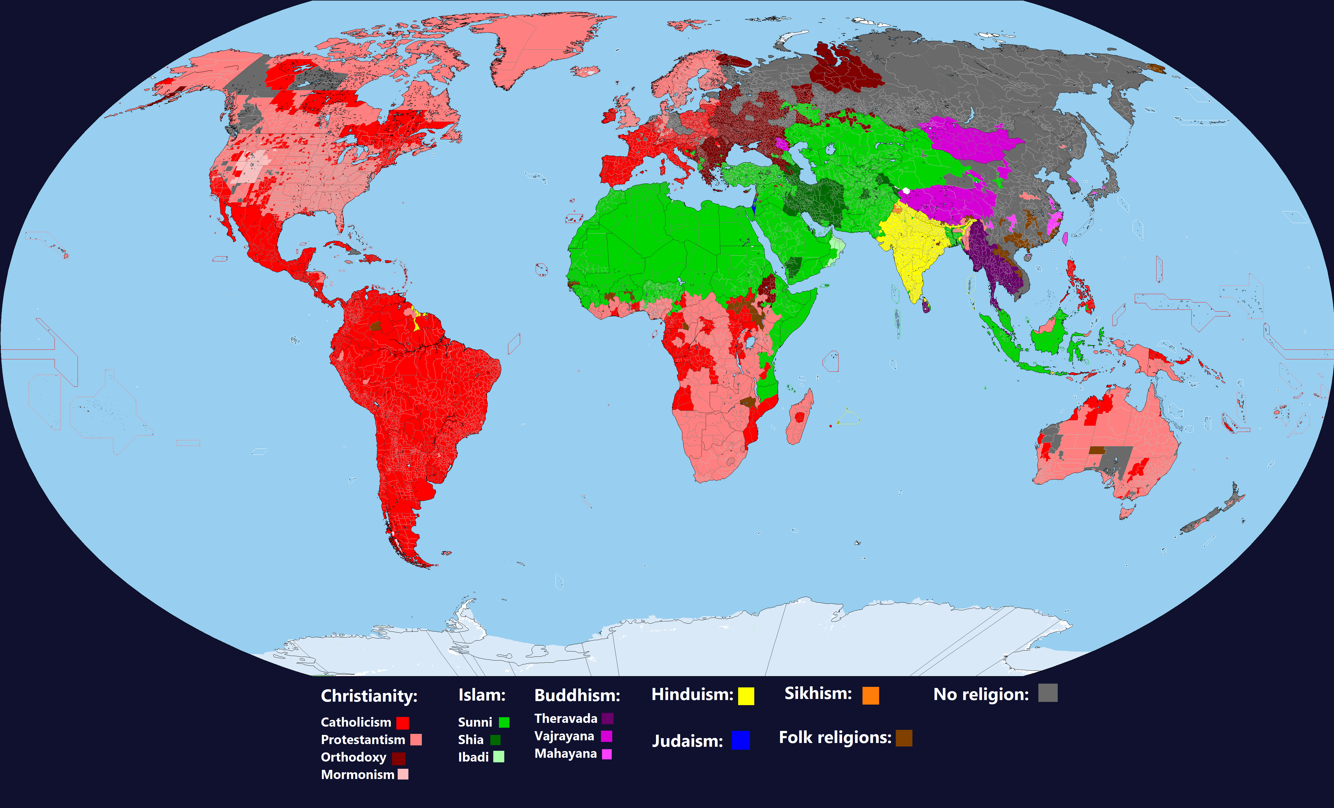
Cultural Distribution of Religions throughout the world

Slide 23
RELIGIOUS IDENTITIES OF THREE GLOBAL BELIEF SYSTEMS
1.
Judeo-Christian
Includes varied teachings of all branches of Judaism, Roman Catholic, Maronite, Eastern / Russian Orthodox, and all denominations of Protestantism.
2.
Islam, Hinduism
Includes Sunni, Shia and other sects of Islam, Bah’ai, and various forms of Hindusim/Buddhismand tribal religions in North Africa, the Middle East, and the Indian subcontinent.
3.
Atheistic/Nones
Includes secular humanism, progressive socialism, Marxism, and Chinese and Russian Communism, especially when these implicitly or explicitly marginalize or discriminate against religious expression.

Slide 24
CORE IDEOLOGIES OF THREE GLOBAL BELIEF Systems
1.
Judeo-Christian
God is Yahweh, the God of Abraham, Isaac, Jacob (Israel). Father, Son, and Holy Spirit.
Christians honor Jesus as Messiah.
Sacrificial Love
Transformaton
Truth is in God and His Word, the Bible.
2.
Islam + Hindu/Buddha
God is Allah of Mecca, claimed to be from Abraham and Ishmael. Hinduism has host of gods, some prominent.
Prophet Mohammed with Jesus, etc lower.
Domination and Rage
Submission
Truth is in Allah, the Qur’an + holy books.
3.
Atheistic/Nones
Materialism only, no mythical human “God.” The sole authorities
over humanity are the self and the state.
Jesus said some good things as a man.
Pride and Power
Revolution
Truth is psychosocially determined by self/state.

Slide 25
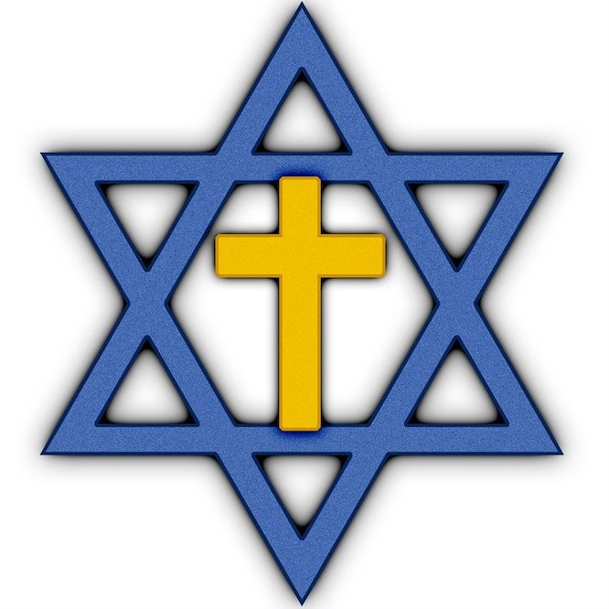
PROMINENT SYMBOLS OF THREE GLOBAL BELIEF Systems
1.
Judeo-Christian
God is Yahweh, the God of Abraham, Isaac, Jacob (Israel). Father, Son, and Holy Spirit.
2.
Islam, Hindu/Buddha
God is Allah of Mecca, claimed to be from Abraham and Ishmael. Hinduism has host of gods, some foremost.
3.
Atheistic/Nones
Materialism only, no mythical human “God.” The sole authorities
over humanity are the self and the state.

Slide 26
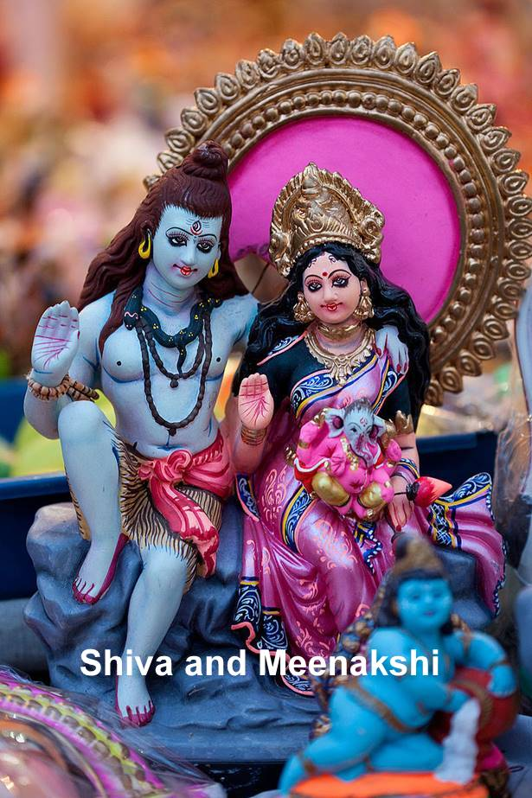
Several of the world’s gods prior to Christ (current?)
Tengri+
Thor+
Zeus+
Kukulkan+
Baal+
Shangdi
Ra+
Hindu+
Yahweh
= YHWH
Allah+
*
Brahma, Vishnu,
Shiva, Meenakshi
Viracocha+
Global population at time of the Exodus was less than 100 million
*1-3 million left Egypt with ~2 million entering Promised Land

Slide 27
Enlightenment
Progressivism
Modernity
Marx
Global population prior to Christ was less than 190 million
The first god to appear in Greek/Roman mythology is Chaos (or Kaos), who represented the void. Chaos gave birth to two children, the Night (Nyx} and Darkness (Erebus). They in turn gave birth to Light (Aether) and Day (Hemera). They were joined shortly thereafter by Earth (Gaia). Earth (Gaia) soon gave birth to her own primordial children, Sky (Uranus) and Sea (Pontus). Time (Cronus) was identified, who fathered the god Zeus who became known as the “Father of Gods and men” and “King of Olympus.”
Confucius
Kukulkan+
Tengri+
Hindu+
Buddha
Shiva
Ra+
Shangdi+
Incas+
Zeus+
Allah
Mohammed
Abraham
Ezekiel
David
Jesus
Adam
Noah
Jacob
Moses
500
1000

Slide 28
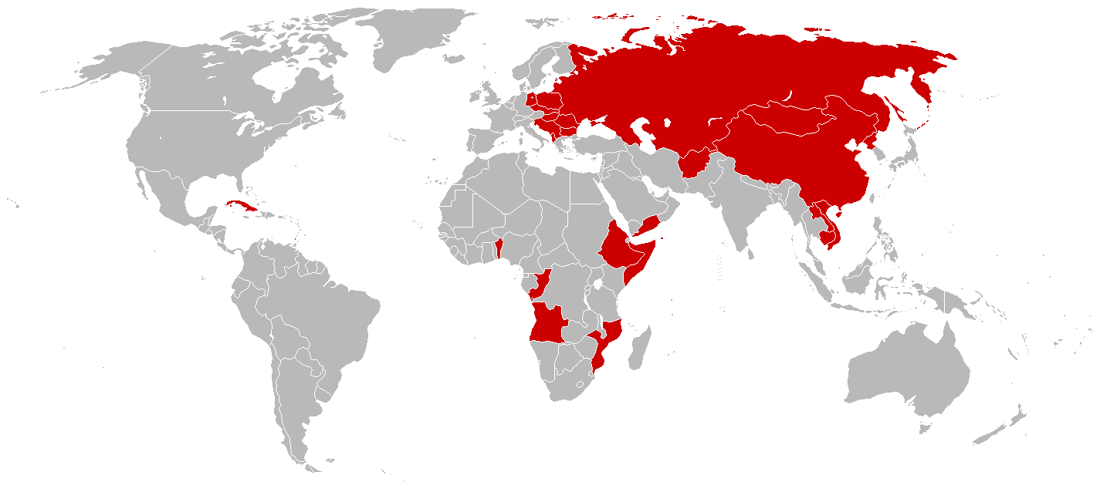
MAPS
our office
Does not include North and South American political situations
Current avowedly Communist countries in the world

Slide 29
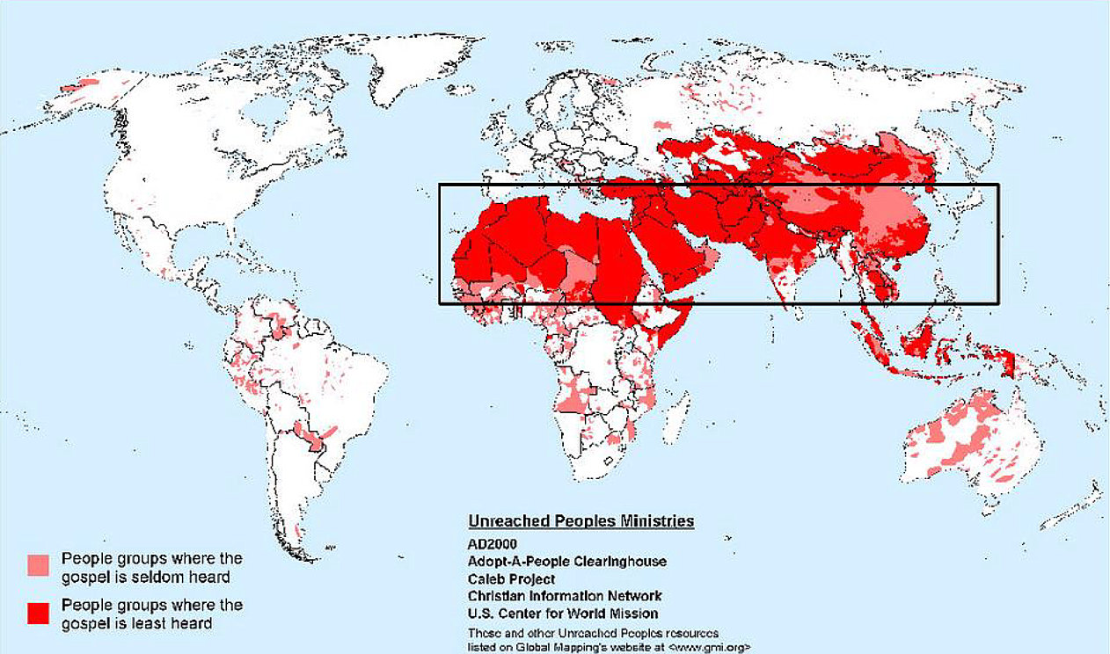
“Window” is from 10 to 40 degrees north of the equator across northern Africa, the Middle East, and Central Asia encompassing 69 nations with nearly 4 billion people including 90 percent of the world's poorest of the poor.
Unreached nations in the “10-40 window”

Slide 30
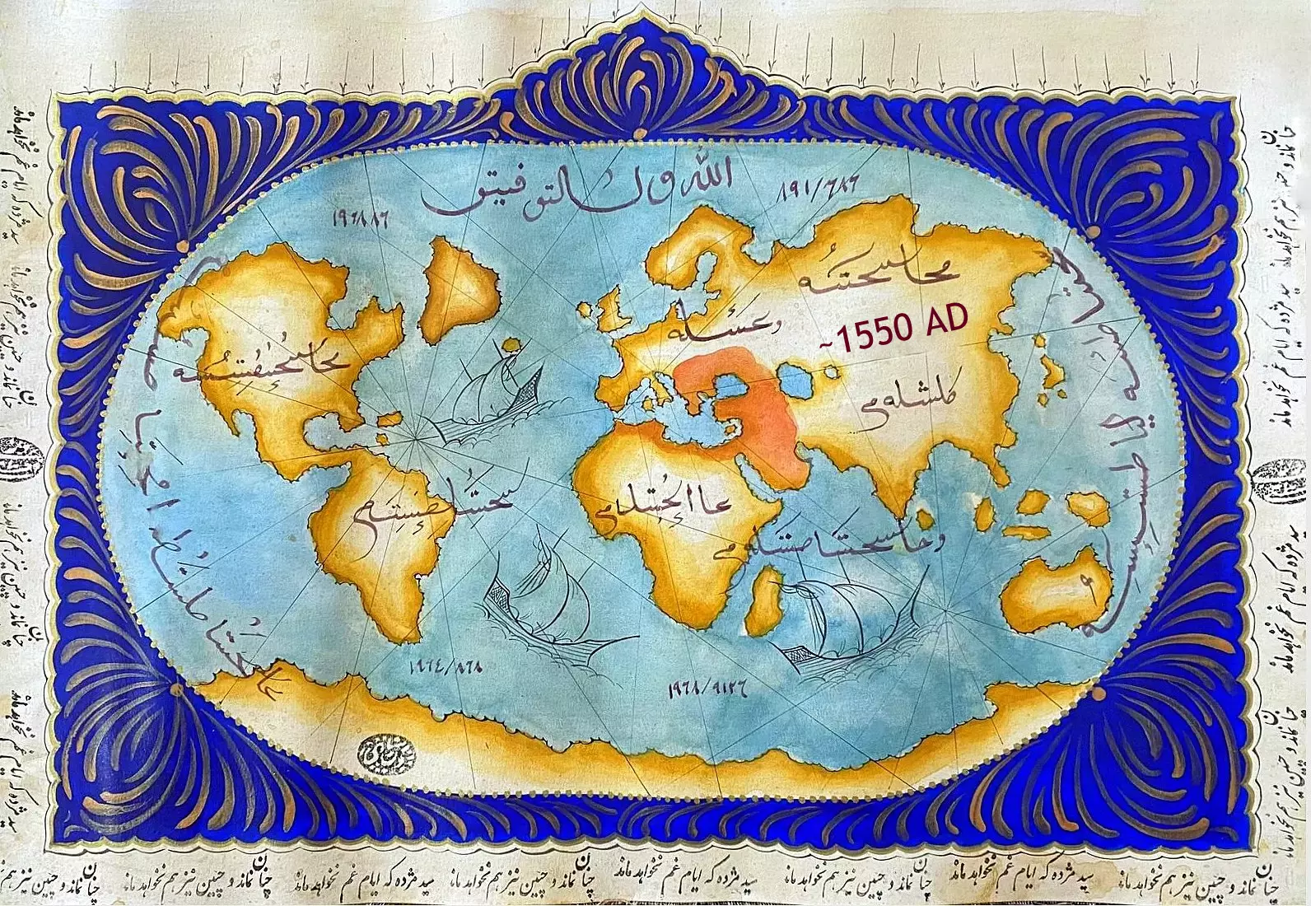
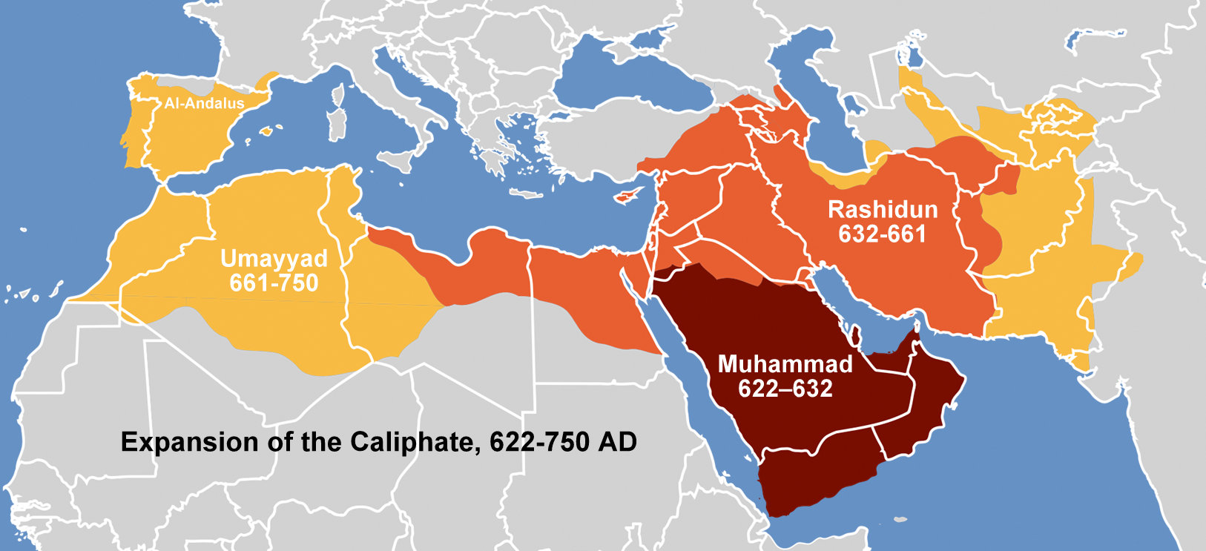
Early conquest of Islam
The “Lost Cause” of Suleman’s Islamic Ottoman Empire

Slide 31
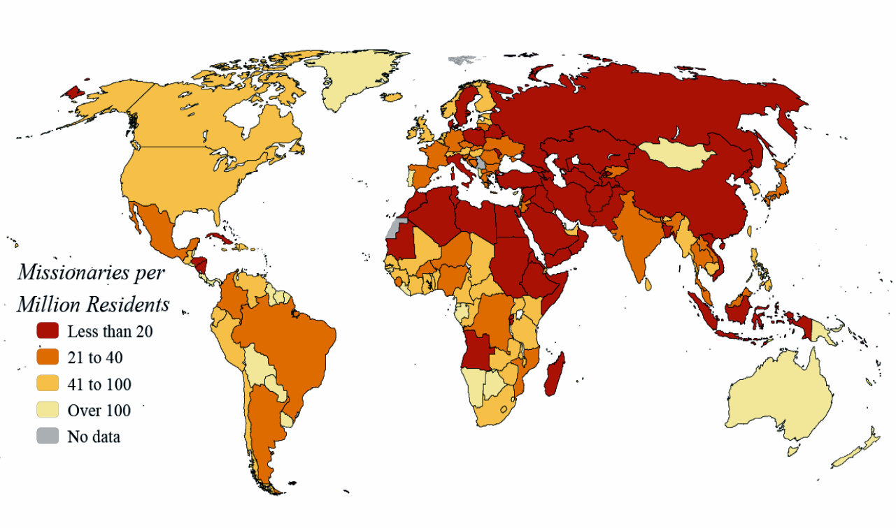
Parts of the world unreached by the Gospel message

Slide 32
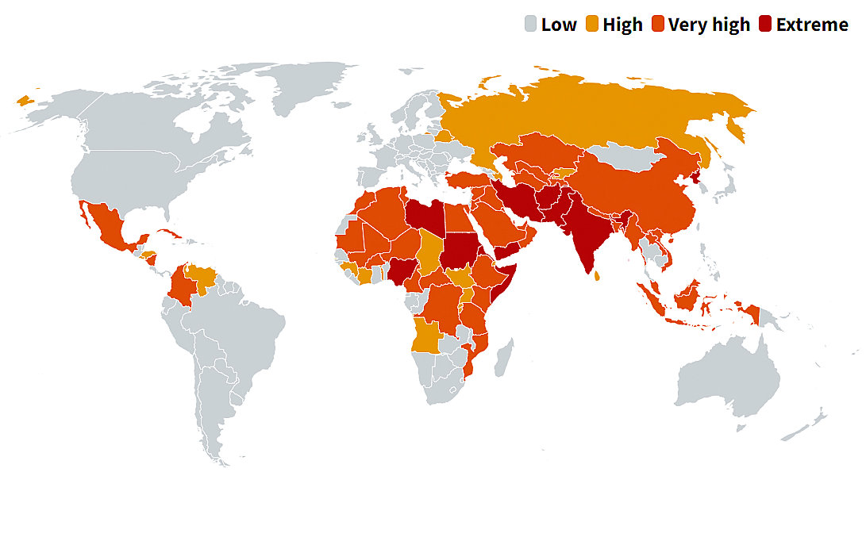
MAPS
World Watch List 2023 most persecuted areas

Slide 33
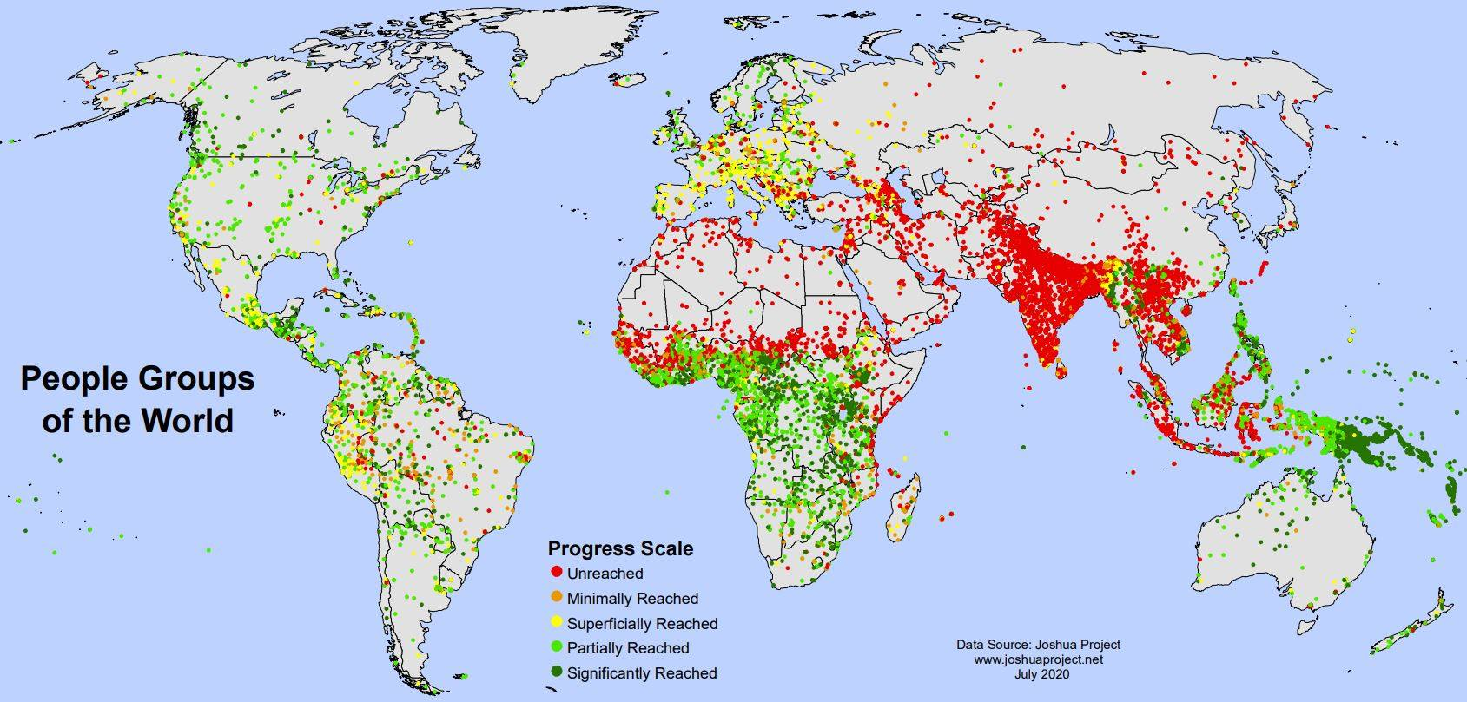
MAPS
?
?
?
?
___________>
The 10/40 Window is located from 10 degrees south to 40 degrees north of the equator.
There are 69 nations across northern Africa, the Middle East, and Central Asia in the 10/40 Window.
Nearly 4 billion people live here, including 90 percent of the world's poorest of the poor.
Most densely populated areas unreached by the Gospel message

Slide 34
MAPS
?
?
?
?
___________>
The 10/40 Window is located from 10 to 40 degrees north of the equator across northern Africa,
the Middle East, and Central Asia. 69 nations with nearly 4 billion people live here,
including 90 percent of the world's poorest of the poor.
Note current affiliations in unreached areas

Slide 35
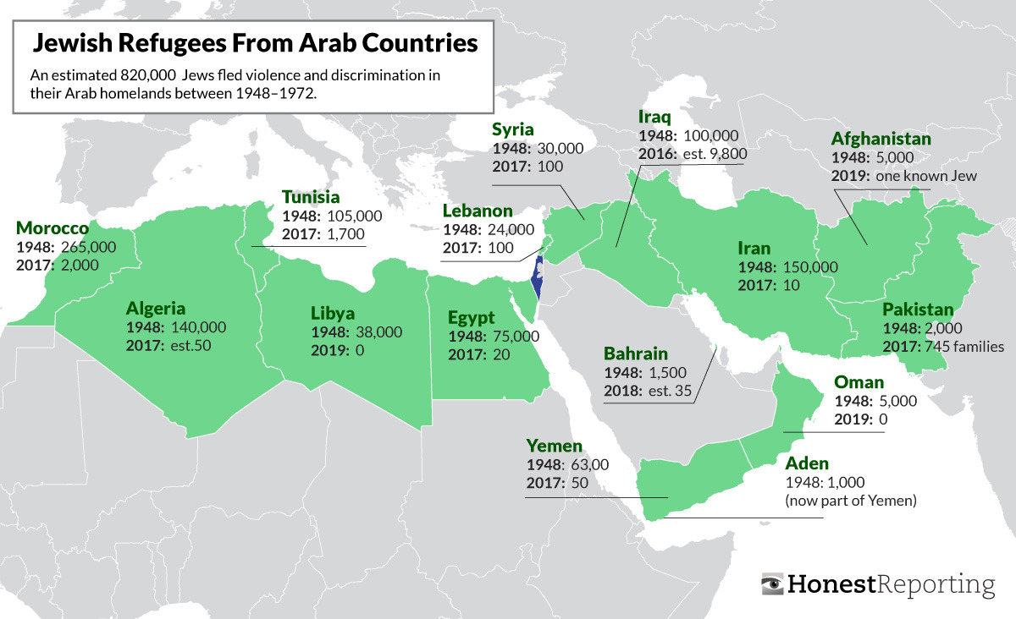
MAPS
Saudi Arabia
Jewish population
scant due to
suppression
There was a mass exodus of Jewish populations who were expelled from or fled violence and discrimination in Middle Eastern countries between 1948 and 1972 in the years following formation of Israel in 1948.
820,000 Forgotten Jewish Refugees of the Arab World

Slide 36
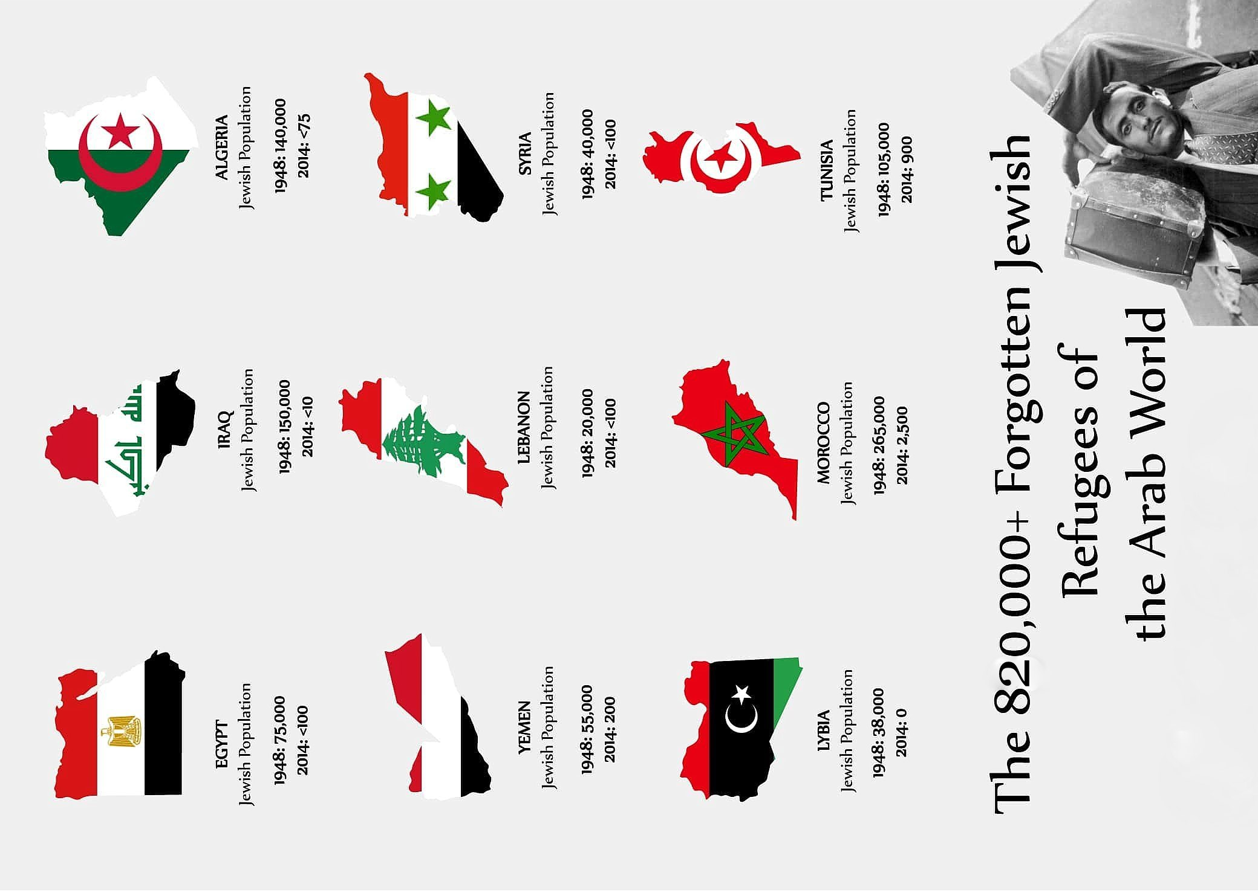
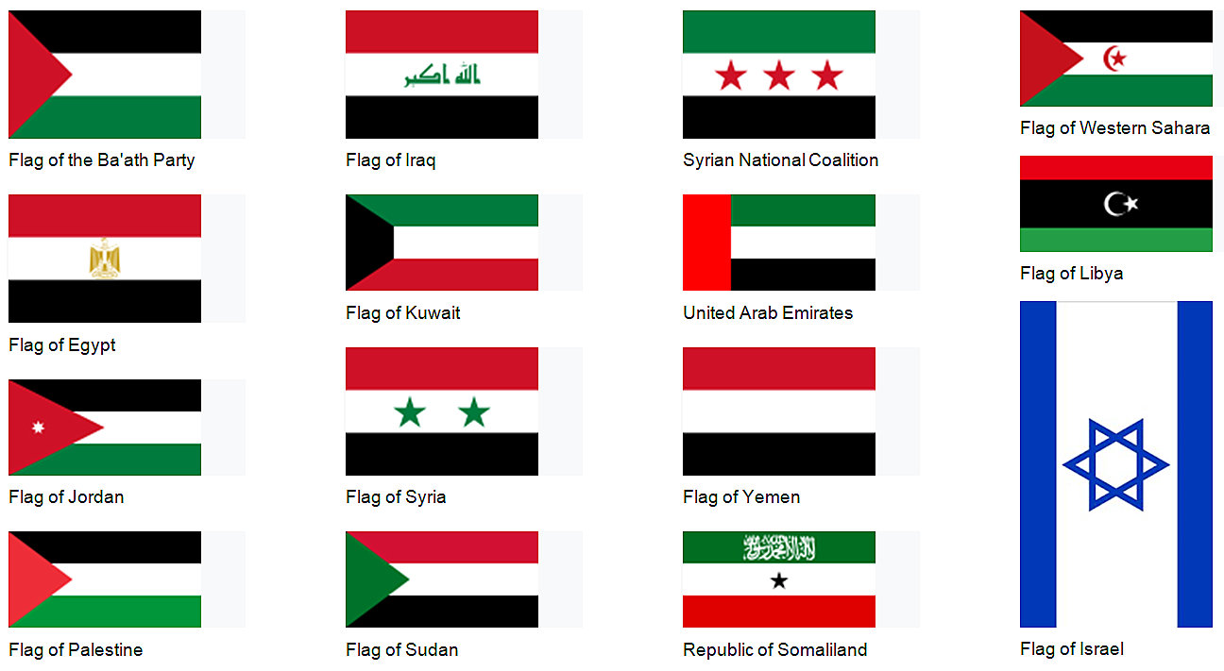
MAPS
National and Political Flags of the Middle East
Ethnic Cleansing in the Middle East, 1948-2023

Slide 37
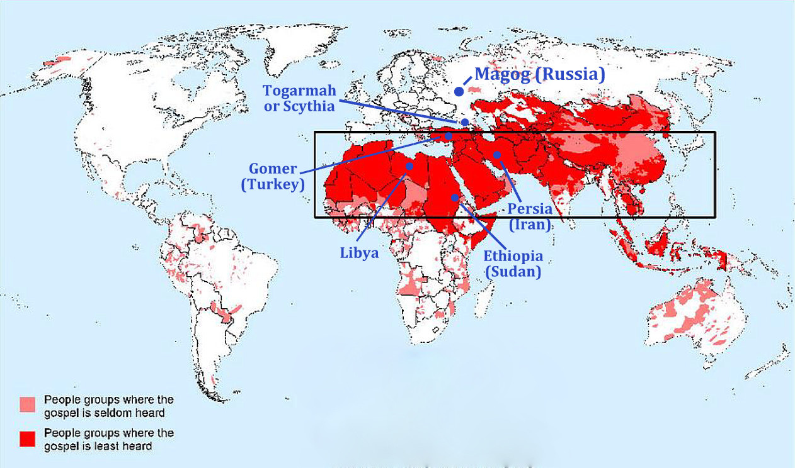
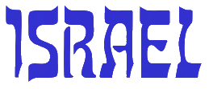
$$•$$
Thus declares the Lord (Yahweh), who stretched out the heavens and founded the earth and formed the spirit of man within him: “Behold, I am about to make Jerusalem a cup of staggering to all the surrounding peoples. The siege of Jerusalem will also be against Judah. On that day I will make Jerusalem a heavy stone for all the peoples. All who lift it will surely hurt themselves. And all the nations of the earth will gather against it.” Zechariah 12:1-3 (read through Chapter 14)
Nations in final end time war on Israel named in Ezekiel 38

Slide 38
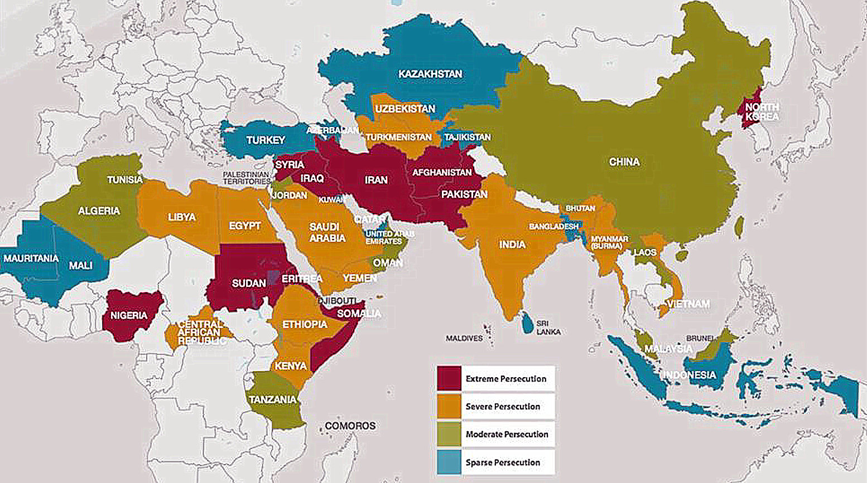
Jerusalem
Overlay of end time battle participants named in Ezekiel 38
Thus says the Lord Yahweh: “This is Jerusalem. I have set her in the center of the nations, with countries all around her.”
Current levels of persecution of Judeo/Christians in 10-40 window

Slide 39
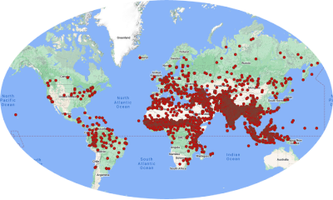
Who is the one true God?
HIGH VALUE 2
Nearly 7,000 Bible references to Yahweh
And he said, “I am the God of your father, the God of Abraham,
the God of Isaac, and the God of Jacob.” Then the Lord (Yahweh) said,
“I have surely seen the affliction of my people.”
Exodus 3:6-7 and Matthew 22:32
“I am the Lord your God (Yahweh), who brought you out of Egypt,
out of the land of slavery. You shall have no other gods before me.”
Exodus 20:2-3
Trust in the Lord (Yahweh) forever, for the Lord Yah is an everlasting rock.
Isaiah 26:4
Yahweh
(I AM, G-D, YHWH, Lord, Hashem)
Israel
LOW VALUE 1
HIGH VALUE 1
Ra
(sun-god)
Egypt
Buddha
(awake)
SE Asia
Self
(godless)
State
Hindu
(Brahma Vishnu, Shiva)
India
Baal
(Belial)
Syria
Allah
('the god’)
Mecca
Astarte
(Ishtar)
Levant
Dagon
(father)
Canaan
LOW VALUE 2
…and the false gods, the spirits of the Antichrist?

Slide 40
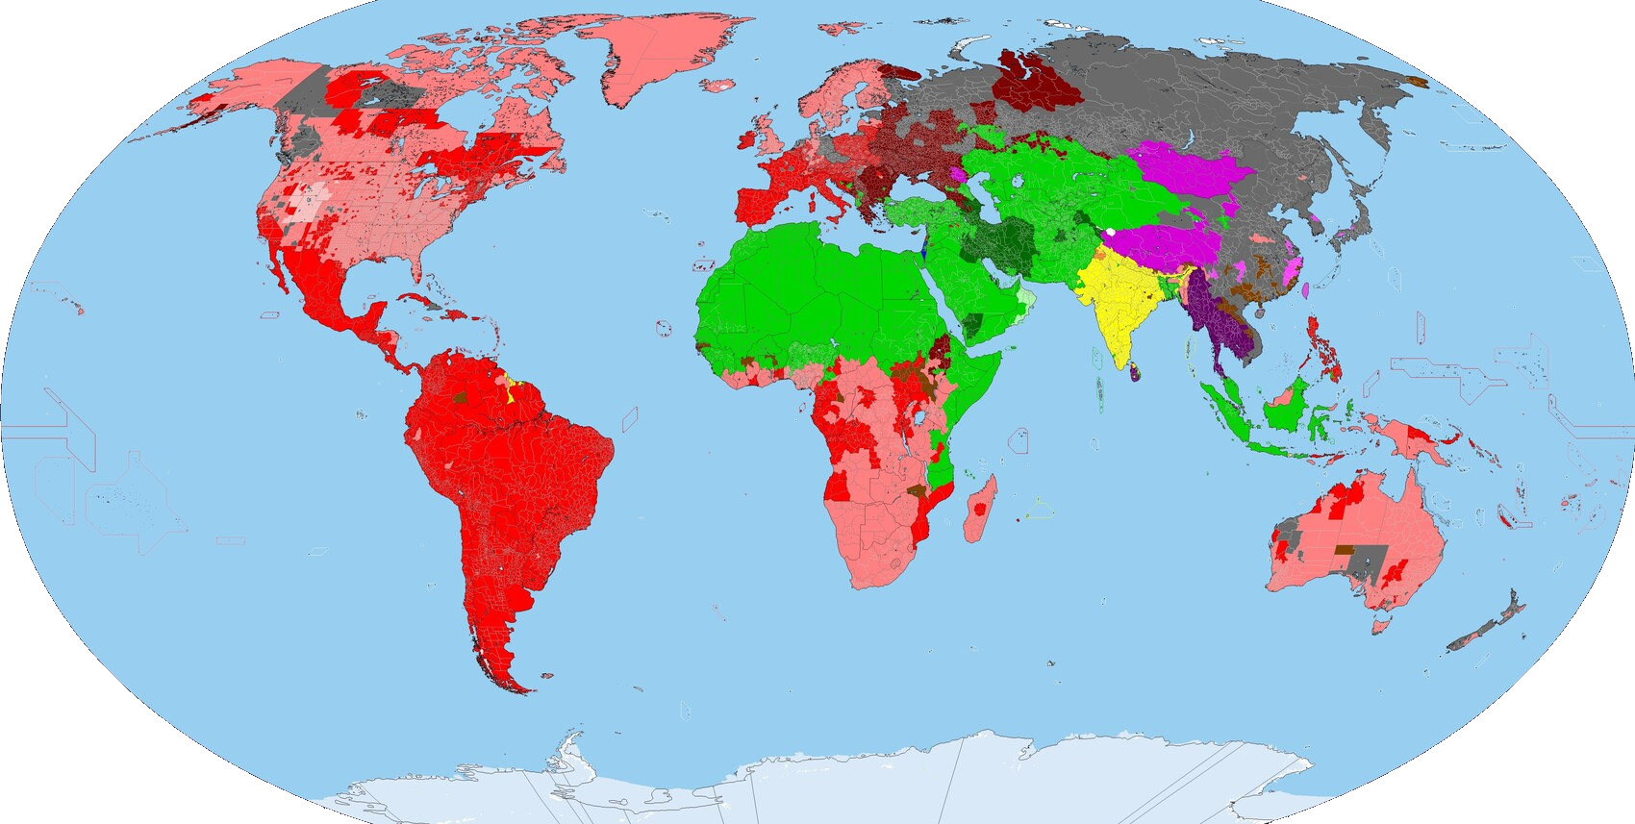
Who is the one true God?
HIGH VALUE 2
LOW VALUE 1
or these
“opiates of
the people”?
HIGH VALUE 1
Yahweh
(I AM, G-D, YHWH, Lord, Hashem)
Israel
LOW VALUE 2
…and the real false gods?

Slide 41
3 quotes about God and Satan
?
I would like to see moral men like Gautama Buddha, who did not believe in a Personal God or a personal soul, never asked about them, but was a perfect agnostic, and yet worked all his life for the good of all.
Swami Vivekananda
In the name of Allah, the Beneficent, the Merciful! Say: ‘He is Allah, the one and only God the Eternal, the Absolute. He begot none, nor was He begotten and there is none comparable to Him.’ Surah #112
The Great Satan is America. Khomeini

Slide 42
? HOW CAN WE COEXIST?
Only with our
EYES AND HEARTS WIDE OPEN AND
PRAYERFULLY!

Slide 43
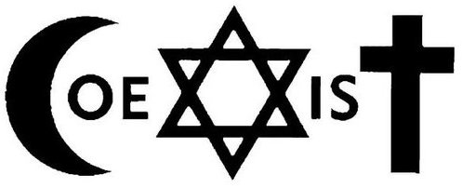
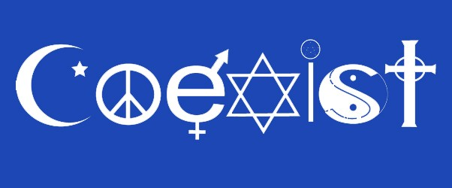
?

Slide 45
Birth Pangs
As he sat on the Mount of Olives, the disciples came to him privately, saying, “Tell us, when will these things be, and what will be the sign of your coming and of the end of the age?” And Jesus answered them, “See that no one leads you astray. For many will come in my name, saying, ‘I am the Christ,’ and they will lead many astray. And you will hear of wars and rumors of wars. See that you are not alarmed, for this must take place, but the end is not yet. For nation will rise against nation, and kingdom against kingdom, and there will be famines and earthquakes in various places. All these are but the beginning of the birth pains.
“Then they will deliver you up to tribulation and put you to death, and you will be hated by all nations for my name’s sake. And then many will fall away and betray one another and hate one another. And many false prophets will arise and lead many astray. And because lawlessness will be increased, the love of many will grow cold. But the one who endures to the end will be saved. And this gospel of the kingdom will be proclaimed throughout the whole world as a testimony to all nations, and then the end will come.
Matthew 24:3-14.

Slide 46
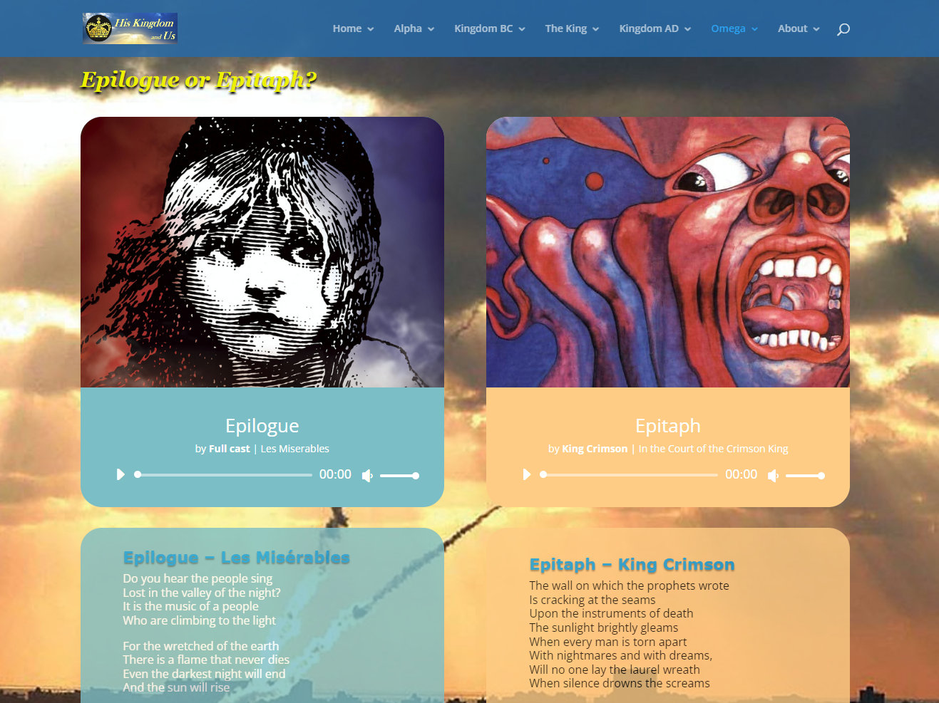
https://hiskingdom.us/omega/epitaph/

Slide 47
or… THE LION OF JUDAH RETURNS AND THE CLOSE OF THE AGE

Slide 48
NEW & old resourceS
The Daily News
The Unseen Realm:
Recovering the Supernatural Worldview of the Bible
Michael S. Heiser, Lexham Press, 2015
The Qur’an and Its Biblical Reflexes
Investigations into the Genesis of a Religion
Dr. Mark Durie, Lexington Books, 2020
The ESV Study Bible plus NJB or WEB
Lane Dennis, et al., 2016 plus ebible.org/web
Gen 2, Deut 32, Daniel 7, Zech 12-14, John 1, etc.
Daily Devotions & Prayer

Slide 49
? QUESTIONS
Dr. Bill Morehouse
Visit me at:
HisKingdom.us
wmorehouse.com
celebratesalvation.org
Or contact me at:
wmorehouse@gmail.com
Mobile (585) 314-1144
Go deep in Bible study, prayer, Google

