Slide 1
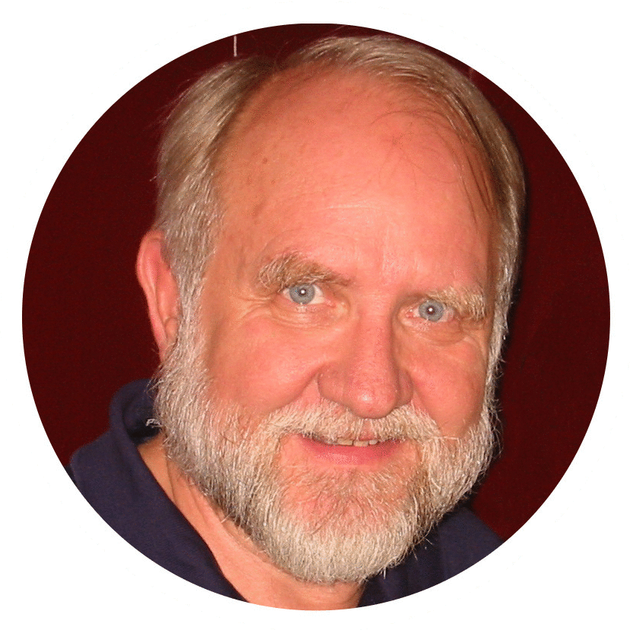
GOOD MORNING! Men’s Bible Study May 26, 2022
Bill Morehouse

Slide 2
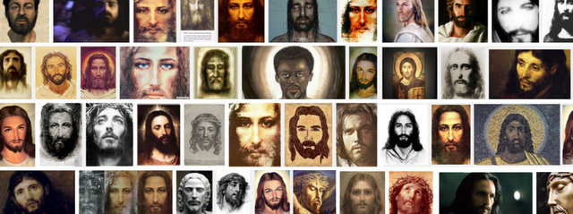
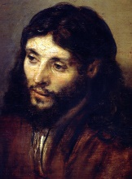
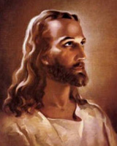
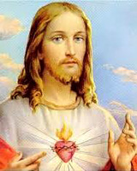
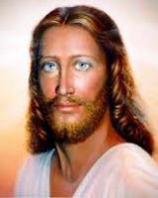

Slide 3
iamrochester.com/showings
May 29 @ 3:00pm June 1 @ 7:00pm June 3 @ 6:00pm June 17 @ 7:00pm June 24
First Pres Church Youth for Christ In Christ New Hope Edgewood Free Meth Parkridge Free Meth 34 E Albion Street 1 Favor Street 155 Pinnacle Road 111 E. Jefferson Road 10 Straub Road Holley, NY 14470 Rochester, NY 14608 Rochester, NY 14623 Pittsford NY 14534 Rochester, NY 14626 (585) 638-6770 (585) 256-5050 585-334-8730 585-244-9200 (585) 227-0990

Slide 4
? DOES IDEOLOGY MATTER?

Slide 5
Ideology definitions
👆
A coherent set of beliefs that informs motivation and action relating to the circumstances of mankind, both material and social, including ultimate meanings about their origins, activities, goals, and destinations.
A systematic body of concepts, especially about human life and society or culture.
A form of social or political philosophy in which practical elements are as prominent as theoretical ones. A system of ideas that aspires both to explain the world and to change it.
Synonyms: credo, creed, doctrine, dogma, gospel, philosophy, testament, worldview.

Slide 6
A Range of Conditions
Utopia – The Kingdom of God on Earth
An ideal world/society where everything works the way it should and people dwell together in harmony
Eutopia – Righteousness, meekness
A condition in which an organ or organization is positioned and functioning properly the way it was designed to operate
Ectopia – Sin (hamartia)
A condition in which an organ or organization is out of order, malpositioned, or not operating properly
Dystopia – Hell on Earth
A nightmare world/society where virtually everything is not working the way it should and people are in constant stress
Can’t go back to the beginning
Can’t control what tomorrow will bring
But I know here in the middle
Is the place where You promise to be
lyric from “Home Again” song by Elevation Worship
“God dwells in a state of perpetual enthusiasm.
He is delighted with all that is good and lovingly concerned about all that is wrong.
A. W. Tozer

Slide 7
My politics
I have one great political idea… That idea is an old one. It is widely and generally assented to; nevertheless, it is very generally trampled upon and disregarded. The best expression of it, I have found in the Bible. It is in substance, “Righteousness exalteth a nation – sin is a reproach to any people.” This constitutes my politics, the negative and positive of my politics, and the whole of my politics… I feel it my duty to do all in my power to infuse this idea into the public mind, that it may speedily be recognized and practiced upon by our people.
Frederick Douglass
“But seek first the Kingdom of God and his righteousness, and all these things will be added to you.”
Jesus

Slide 8
Thoughts about “America”
Three thousand years ago Solomon wrote “Where there is no prophetic vision the people cast off restraint, but blessed is he who keeps the law.”
Just before it was ratified in June 1788, James Madison wrote that our Constitution requires “sufficient virtue among men for self-government,” otherwise, “nothing less than the chains of despotism can restrain them from destroying and devouring one another.”
10 years later in 1798 John Adams observed, “Our Constitution was made only for a moral and religious People. It is wholly inadequate to the government of any other.”
Our Pledge of Allegiance was written in 1892 and, with the addition of “under God” in 1954, became “I pledge allegiance to the flag of the United States of America, and to the republic for which it stands, one nation under God, indivisible, with liberty and justice for all.”
“Ungovernable!” ?

Slide 9
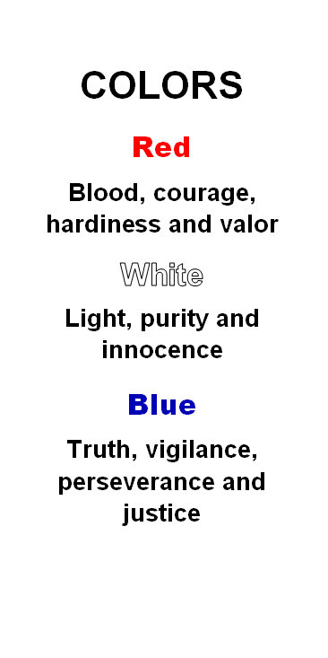
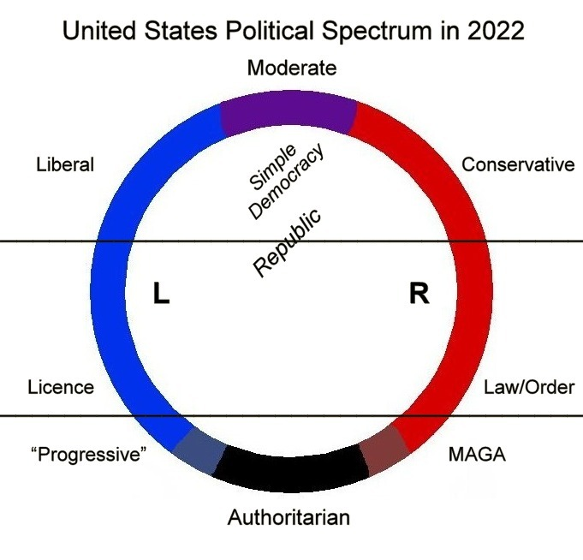
White = God
The One who fills all in all
and is
ready and able
to extinguish the flames and lead us in love to freedom, dignity, honor, joy, and peace.
And everyone who competes for the prize is temperate in all things. Now they do it to obtain a perishable crown, but we for an imperishable one.
1 Corinthians 9:25
Notes:
Newscasts and daily political shows have spent countless hours of airtime telling their viewers that the war in Ukraine is not, in fact, a war, but instead a “special military operation” designed to spare civilians. The Russian forces are portrayed as liberators, fighting against what the propaganda calls the “neo-Nazis” who are said to overrun Ukraine under the influence of the United States and it allies and are allegedly committing “genocide” against Russian-speaking Ukrainians.

Slide 10
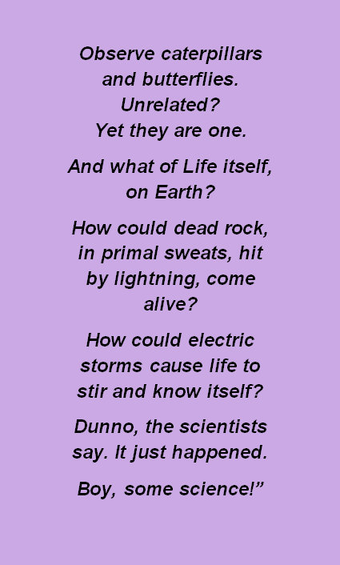
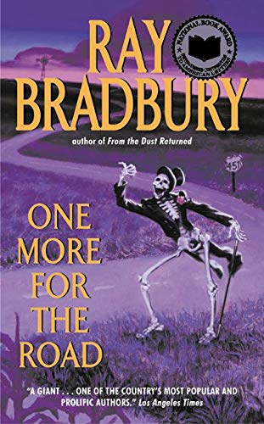

Slide 11
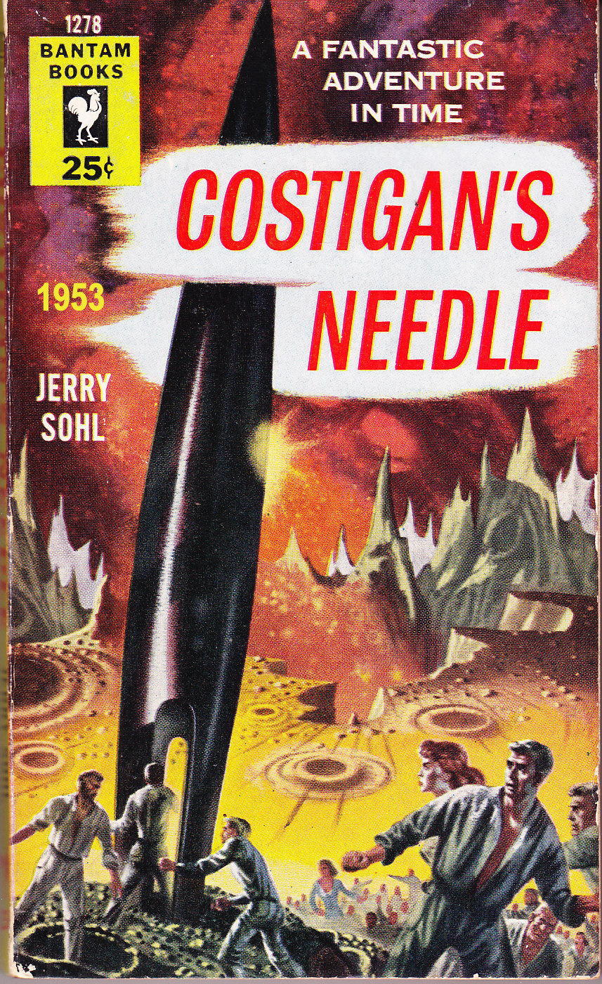
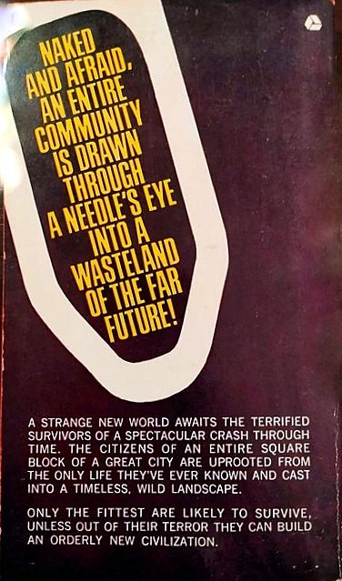

Slide 12
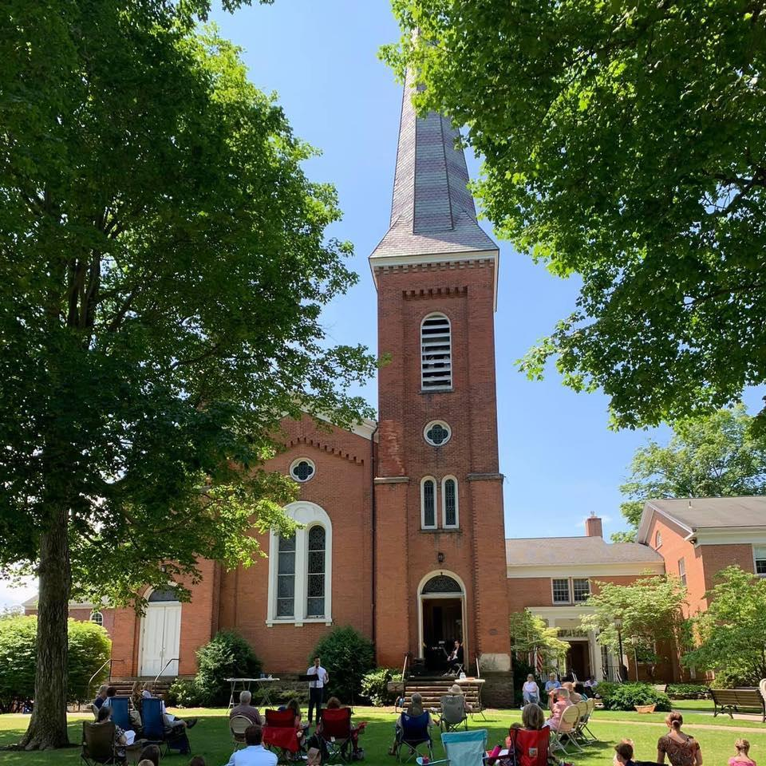
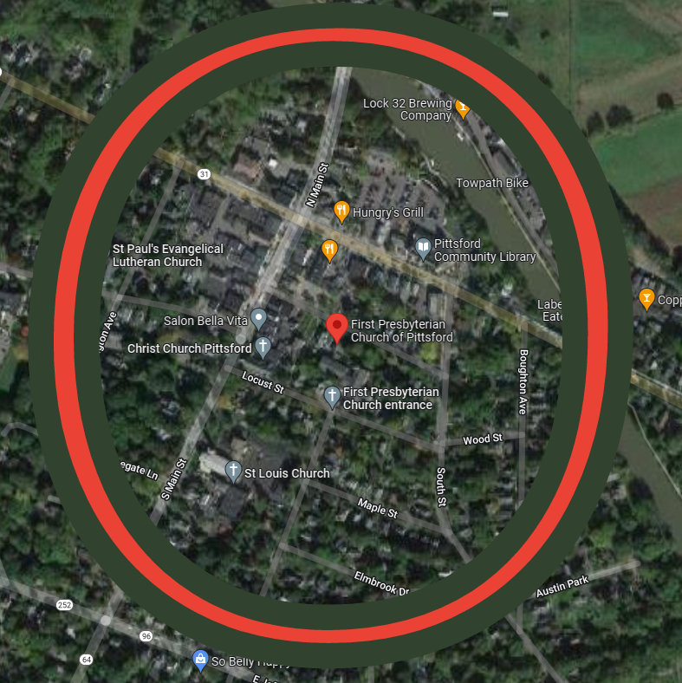
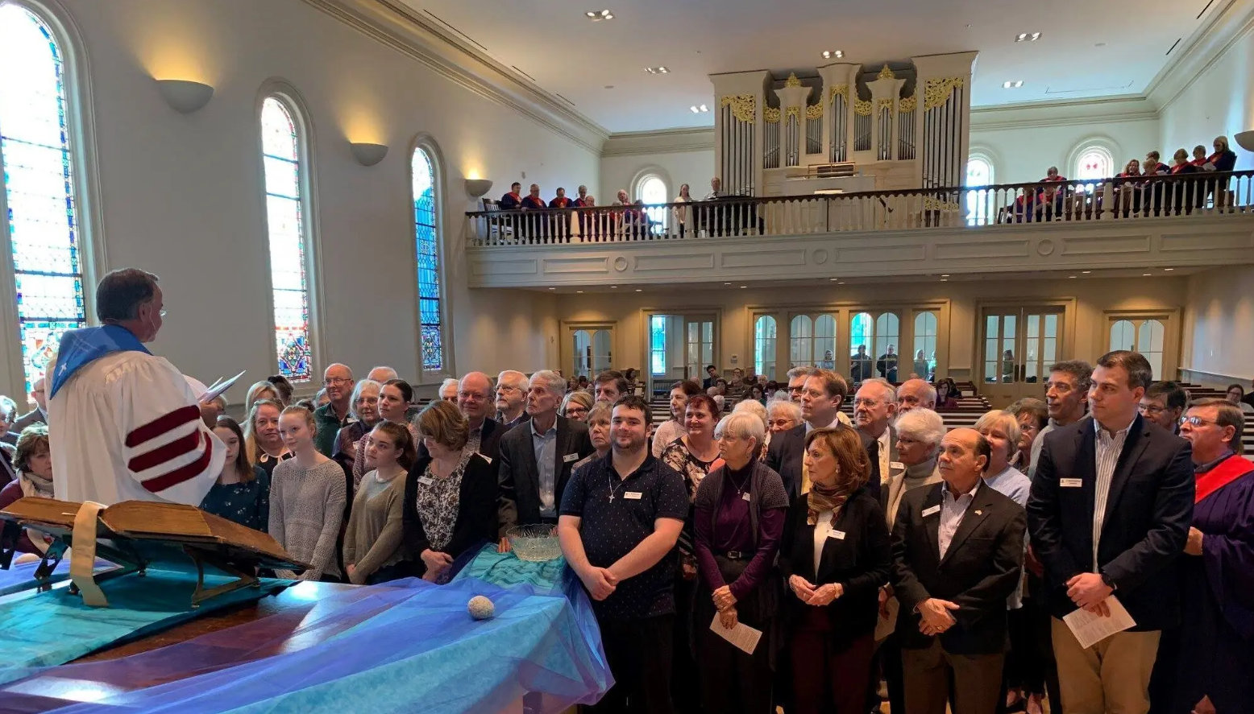

Slide 13
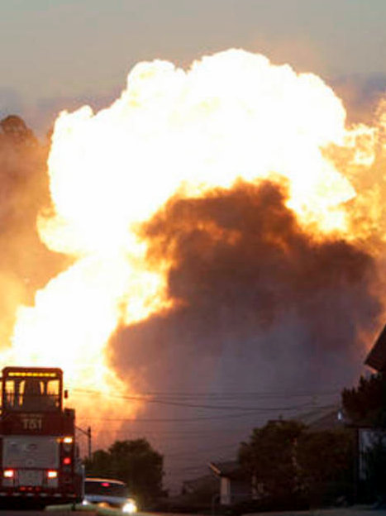
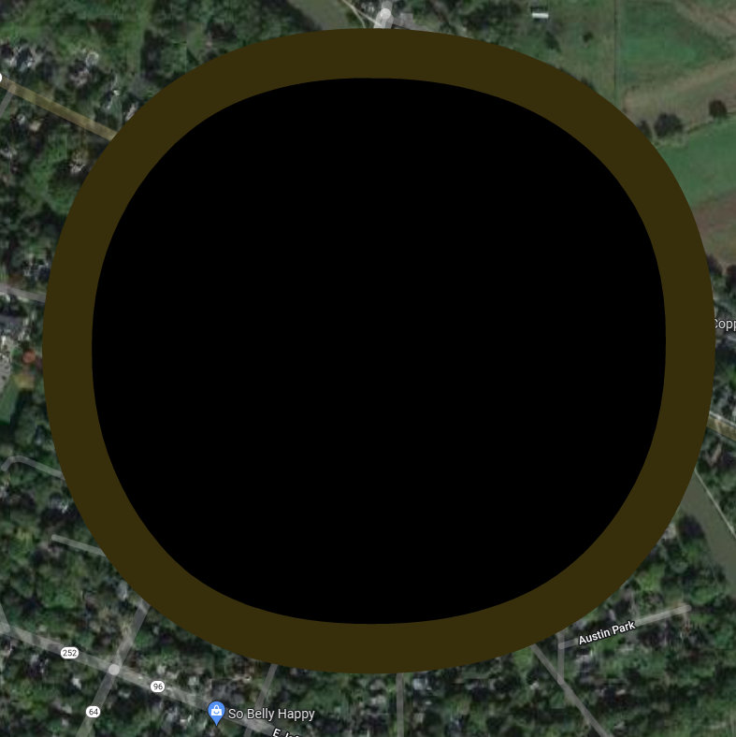

Slide 14
Death:
“Here is a small fact: You are going to die."
opening sentence of The Book Thief
“It is appointed for man to die once, and after that comes judgment." _{Hebrews 9:27}
Notes:
Here is a small fact: You are going to die. I am in all truthfulness attempting to be cheerful about this whole topic, though most people find themselves hindered in believing me, no matter my protestations. Please trust me. I most definitely can be cheerful. I can be amiable. Agreeable. Affable. And that's only the A's. Just don't ask me to be nice. Nice has nothing to do with me.

Slide 15
HERE & NOW THE HEREAFTER
Four Questions any Ideology Needs to Answer:
Where did we all come from?
What is the source of good and evil?
What will happen to us after we die??
How should we live in the here and now?

Slide 16
2 WORLD IDEOLOGIES
What about “Moralistic Therapeutic Deism” as a compromise?
Chosen as comparison examples for illustration and deeper understanding because they are current, overlapping viewpoints that are intrinsically – even dialectically – opposed to one another.

Slide 17
Moralistic Therapeutic Deism
👆
How similar is this to “Third Way” political
compromise
?
A God exists who created and ordered the world and watches over human life on earth.
God wants people to be good, nice, and fair to each other, as taught in the Bible and by most world religions.
The central goal of life is to be happy and to feel good about oneself.
God does not need to be particularly involved in one's life except when God is needed to resolve a problem.
Good people go to heaven when they die.

Slide 18
OUR CULTURE WAR
A culture war is a cultural conflict between social groups and the struggle for dominance of their values, beliefs, and practices. It commonly refers to topics on which there is general societal disagreement and polarization in societal values.

Slide 19
Underlying Biblical Recognition
Behind every ideology lie spiritual forces that define it and hold its pieces together in a comprehensive whole. A gift of the Holy Spirit called “the gift of discernment” is offered to us as Christians to help guide our decision-making into truth.
We, like impartial judges and juries, are interested in finding “the truth, the whole truth, and nothing but the truth” and are seeking in the process to avoid not only frank falsehoods but half-truths as well.

Slide 20
1. CRUCIAL
The combined record of both Biblical Testaments reveals a comprehensive and true ideology of life and the origin, nature, and governance of the matter, space, and time that constitute our universe, including mankind both within and beyond.

Slide 21
Crucial definition
👆
Etymology: from Latin “crux” meaning “cross”
A decisive or critical turning point, especially in the success or failure of something.
An extremely important decision, event, or question because many other things, including the end result, depend on it.
An essential, final, vital, or otherwise very important test or decision.
Synonyms: vital, important, pressing, essential, urgent, momentous, high-priority

Slide 22
Crucial theory elements
👆
All of the time, space, matter, energy, order, and life in our universe was created by an amazing, personal, triune God who dwells in eternity.
God has revealed His omnipotence in creation and His divinely loving, compassionate, and omniscient character to us, not only in Nature but in the Word of the Bible as confirmed by the witness of His Holy Spirit.
We were uniquely created by God in His Image, each with our own free will which inevitably causes all of us to differ with Him. In spite of our sin, He offers to be intricately involved with and committed to each one of us individually as well as all of us together. Those who deny God’s existence and care are choosing to remain separate from Him in this life and the next.

Slide 23
Salvation & the Kingdom of God
👆
Salvation is the process by which the God who created and sustains us then redeems us from sin and eternal death by revealing the deeply engrained errors of our ways to us (conviction), empowering us to confess and turn from our sin (repentance), winning our hearts (conversion), reconciling us to Himself in forgiveness (adoption), and continuing to cleanse us from sin by His Word and Spirit (sanctification).
The Kingdom of God is the comprehensive, merciful, just, lawful, orderly, perfect, and ongoing rule and reign of God in the universe He created, through which He guides and leads us into His righteousness and wisdom as we seek to be faithful stewards of all He has entrusted to us.
The witness of the Holy Bible

Slide 24
Salvation & Christ’s Lordship
👆
God the Father has sent His only begotten Son, Jesus, to reveal His true nature, reconcile us to Him in eternal love, and empower us by His Holy Spirit to live increasingly pure and victorious lives.
He has delegated all authority in Heaven and Earth to His Son, our Savior, who rules and reigns over His vast and intricate Kingdom and will continue until the culmination of time.
Through faith/trust in Jesus’ obedience in dying on the cross to take the punishment for our willfulness, being raised from the dead, and sending His Holy Spirit to guide us, we receive God’s love, learn to joyfully obey Him and His truth, and have the assurance of spending life eternally in union with Him.

Slide 25
Crucial Theory expanded
👆
For we do not wrestle against flesh and blood, but against the rulers, against the authorities, against the cosmic powers over this present darkness, against the spiritual forces of evil in the heavenly places. _{Ephesians 6:12}
The reason the Son of God appeared was to destroy the works of the devil. _{1 John 3:8}

Slide 26
2. CRITICAL
The origin, governance, and power dynamics of the universe and mankind can be scientifically explained solely in materialistic and human terms without reference to any imagined divine involvement.

Slide 27
Critical definition
👆
Etymology: from Latin “criticus” = “judgmental”
Exercising or involving judgment or judicious evaluation to see a thing clearly in order to judge it properly.
Consisting of or involving criticism, or inclined to look for and point out faults and defects.
Relating to or being a transition point or specially important juncture.
Synonyms: evaluative, analytical, expository, faultfinding, judgmental, grave, serious, dangerous, risky

Slide 28
Critical Theory background
👆
Internet Encyclopedia of Philosophy
“The Frankfurt School, known more appropriately as Critical Theory, is a philosophical and sociological movement spread across many universities around the world. It was originally located at the Institute for Social Research at the Goethe University in Frankfurt, Germany. The Institute was founded in 1923 with the aim of developing Marxist studies in Germany. After 1933, the Nazis forced its closure, and the Institute was moved to the United States where it found hospitality at Columbia University in New York City.”
Politica Magazine, May 2022
“Critical race theory is an analytical framework developed by legal scholars that examines how race and racism have become ingrained in American law and institutions since slavery and Jim Crow.”

Slide 29
Critical Theory elements
👆
A philosophical approach to culture involving assessment and critique of society and culture that seeks to confront the social, historical, and ideological forces and structures that produce and constrain it. The term is derived from the Marxist work of the Frankfurt School.
A social theory that aims to critique and change society as a whole. Critical theories attempt to find the underlying assumptions in social life that keep people from fully and truly understanding how the world works.
Any idealistic or metaphysical claims about life after death or a god or grand designer beyond the material world we see are baseless and irrelevant.

Slide 30
Dialectial & Historical Materialism
👆
Dialectical materialism is the world outlook of the Marxist-Leninist party. It is called dialectical materialism because its approach to the phenomena of nature its method of studying and apprehending them, is dialectical, while its interpretation of the phenomena of nature, its conception of these phenomena, its theory, is materialistic.
Historical materialism is the extension of the principles of dialectical materialism to the study of social life, an application of the principles of dialectical materialism to the phenomena of the life of society, to the study of society and of its history.
Joseph Stalin, September 1938

Slide 31
What is Dialectial Materialism?
Metaphysics is “the science of things that transcend what is physical or natural.”
👆
Dialectics: dialego = “to discourse, to debate”
In its proper meaning, dialectics is the study of the contradiction within the very essence of things, the ‘struggle’ of opposites. Lenin ~1914
In its essence, dialectics is the direct opposite of metaphysics. Joseph Stalin 1938
Materialism: materialis = “made of matter”
A philosophy that nothing exists except matter, naturalism.
The materialistic outlook on nature means no more than simply conceiving nature just as it exists, without any foreign admixture. Frederich Engels ~1880

Slide 32
What is Dialectial Materialism?
👆
The world, the all in one, was not created by any god or any man, but was, is, and ever will be a living flame, systematically flaring up and systematically dying down.
Heraclitus
[This statement by Heraclitus] is a very good exposition of the rudiments of dialectical materialism.
Lenin

Slide 33
Dialectical Materialism summary
👆
See Schwarz Report for more about theoretical background
The godless ‘struggle’ of opposites:
The world and all of society is intrinsically godless, materialistic, and binary by being divided into two struggling opposites, those who are oppressed and their oppressors. Dialectics fosters progress.
Binary power dynamics can be identified in economic, racial, sexual, and gender realms, with others still being discovered.
The critical approach to effecting change is by struggling politically and then with force or violence if necessary or expedient.
The desired result is deconstruction and revolution, which involves the elimination and overturning of the old understandings and power dynamics and replacing them with different sets of new ones.

Slide 34
Dialectial Materialism expanded
👆
The godless ‘struggle’ of opposites:
A power struggle between workers (proletariat) and upper classes (bourgeoisie) for control of the means of production. Marx, Engels
A power struggle between whites and non-whites (BIPOC) for control of benefits, governance, narrative, and rights.
Angela Davis, Ibram X. Kendi
A power struggle between straight white cisgender males and all others (LGBTQI+) for control of sexual identity and morality.
Patrisse Cullors, BLM, others

Slide 35
JOHN LENNON – Imagine, 1971
Verse 1:
Imagine there's no heaven; It's easy if you try. No hell below us; above us, only sky. Imagine all the people livin' for today… Ah……
Imagine there's no countries; It isn't hard to do. Nothing to kill or die for and no religion, too. Imagine all the people livin' life in peace…
Chorus:
You … you may say I'm a dreamer, but I'm not the only one. I hope someday you'll join us, and the world will be as one…
Verse 2:
Imagine no possessions; I wonder if you can. No need for greed or hunger – a brotherhood of man. Imagine all the people sharing all the world…
AABWM 1940, ID straight white cis-gender male, pronouns he/him, addict/dreamer/musician

Slide 36
ANGELA DAVIS – activist, 1962-
“There is so much history of this racist violence that simply to bring one person to justice is not going to disturb the whole racist edifice… Racism cannot be separated from capitalism.”
"You have to act as if it were possible to radically transform the world. And you have to do it all the time… I'm no longer accepting the things I cannot change – I'm changing the things I cannot accept."
AABBF 1944, ID lesbian black cis-gender female, pronouns she/her, activist/author/teacher

Slide 37
IBRAM X. KENDI – anti-racist guru
“I’m a preacher’s kid. Jesus was a revolutionary. And the job of the Christian is to revolutionize society, to liberate society from the powers on Earth that are oppressing humanity.”
“Savior theology is a different type of theology that goes right in line with racist ideas and racist theology. That type of theology breeds bigotry. Anti-racists fundamentally reject savior theology.”
AABBM 1982, ID straight black cis-gender male, pronouns he/him, activist/author/teacher

Slide 38
PATRISSE CULLORS – BLM co-founder
“In high school, I came out to my friends as queer. My entire world opened up; this was a monumental step toward unveiling my truest self. I had my first girlfriend when I was sixteen years old. ”
“In June of 2015 – the same month Obergefell was decided – I met Janaya Khan. I knew without a doubt that Janaya, a black transgender immigrant, was my life partner. We could build a new narrative steeped in the intersections of black love.”
AABBF 1983, ID queer black cis-gender female, pronouns she/her, activist/artist/writer

Slide 39
JANAYA KHAN – BLM co-founder
“We think that we live in a society organized around these binaries. But if there isn’t just the gender of male and female, then maybe a lot of other things in society aren’t true either. We have to let go of the scripts we’re born into.”
“We’re building a belief system – a world outside the colonial imagination. Our job Is to make revolution irresistible. We become remarkable when we fight for freedom, justice and liberation.”
AABBM 1987, ID transgender black non-binary, pronouns they/them, activist/boxer/model

Slide 40
JAMIE MANSON – Catholics for Choice
“I support abortion access because of my Catholic faith. Catholics are taught a theology of social justice, and abortion bans are the opposite of justice. What we're seeing right now is religious overreach led by Catholic bishops.”
“Abortion bans create profound suffering
among those who are already oppressed by sinful structures of racism, gender inequality, economic insecurity,
and immigration restrictions.”
AABBF ~1977, ID queer white lesbian, pronouns she/her? activist/editor/columnist

Slide 41
DEI *
* Or should it be
abbreviated
as IED or DIE?

Slide 42
OUR CHOICES
CRITICAL THEORY
– False Gospel
Godless, man-centered
Hate, phobia, discrimination
Anger, resentment, cancel
Grievance, complaint
Breaking out from under
Truth/reality a social construct
No salvation + humanist utopia
Life here is all there is
Blurred boundaries, license
Lawlessness, bondage
Race binary, Sex spectrum
Rebellion
Worldly revolution
Hubris, pride, struggle
Source: ‘Angel of Light’
CRUCIAL NEWS
– True Gospel
God Creator, Savior, King
Sin, transgression, rebellion
Mercy, love, forgiveness
Gratitude, praise
Called out of the World
Truth/reality absolute
Salvation + Kingdom of God
Eternal Life
Boundaries, discipline
Rules, order, freedom
Sex binary, Race spectrum
Repentance
Godly transformation
Humility, prayer, trust
Source: Holy Spirit

Slide 43
Calling to the Ekklesia:
And if it seems evil in your eyes to serve the Lord, choose this day whom you will serve… but as for me and my house, we will serve the Lord.
Joshua 24:15

Slide 44
Promise to the Ekklesia:
I write these things to you who believe in the name of the Son of God, that you may know that you have eternal life.
1 John 5:13

Slide 45
Out and humble:
Therefore come out from their midst, and be separate from them, says the Lord, and touch no unclean thing; then I will welcome you.
2 Corinthians 6:17
Not by might, nor by power, but by my Spirit, says the Lord of hosts.
Zechariah 4:6

